Slide 1
Biomeiler Twickel Foundation
By: Gert Jan Tijans (Project Leader construction)

Slide 2
Table of Contents
Biomeiler Twickel Foundation
What is a biomeiler
Biomeiler Kitchen Garden Twickel
Results
Recommendations

Slide 3
What is a biomeiler?
A biomeiler is a system that composts organic materials. The heat generated during the composting process can be used.
Various forms, volumes, and heat exchangers can be adapted, based on goals and preferences.
www.twickel.nl 3

Slide 4
What is a biomeiler?
Input
Input: Biomass: wood chips, green waste, prunings, grass clippings, leaves, uncomposted parts from a previous biomeiler (sifted)
manure (antibiotic-free)
water
Process: Composting with oxygen (aerobic): :
Carbon..Hydrogen..Oxygen.. + H2O (water) + O2 (oxygen) → CO2 (carbondioxide) + H20 (water) + heat
Output:
Compost for garden or soil improvement, increased organic matter in soil.
Energy / heat
www.twickel.nl 4

Slide 5
What is a biomeiler?
Motivations / reasons for Building a biomeiler:
Processing residual flows: prunings, grass clippings, leaves, green waste.
Energy production (estimated at 1 to 12 KW per 100 m3 (10-120 W /m3 biomass, depending Carbon-Nitrogen ratio
Compost for Carbon dioxide fixation
Compost for increasing organic matter in soil
Compost for improving water retention in soil.
Gaining experience and knowledge
www.twickel.nl 5

Slide 6
Biomeiler Kitchen Garden Twickel
Goal of the Twickel biomeiler:
Gaining experience in the following areas: construction, heat production, compost processing, and break down.
Compost for the kitchen garden.
Reducing energy consumption (gas) at Iron House (greenhouse).
Location:
Kitchen garden at Twickel near the Iron House (greenhouse). To heat the Iron House and use the compost.
www.twickel.nl 6

Slide 7
Biomeiler Kitchen Garden Twickel
Form and look:
An oval shape was chosen to maximize the surface area within the available space.
Without plastic. Aesthetic in a monumental environment.
Energy:
Expected output 6 KW for a volume of 115m3.
www.twickel.nl 7

Slide 8
Biomeiler Kitchen Garden Twickel
Used materials:
18 steel mash panels 15x15cm 5mm
Wooden logs for easy unloading of the biomeiler with a shovel.
Silage tarp for covering the heat exchangers
4 pe heat exchangers 100m1 = total 400 m1
Installation kit (pump, mixing valve, etc.) at Biomeiler foundation.
Filling material: only fresh poplar wood chips, 115 m3
Added water 15m3, more water was not absorbed. Water circulated through a sprinkler at the top for the first 5 days.
www.twickel.nl 8

Slide 9
Biomeiler Kitchen Garden Twickel
Cost of biomeiler materials (including VAT)
€. 690,00 steel mesh panels
€. 3.900,00 poplar chips unload crane truck
€. 250,00 water transport by truck
€. 1.200,00 installation kit Biomeiler foundation
€. 170,00 silage tarp
€. 1.000,00 500 m1 pe pipe 25x2.7 (certified) uncertified costs €. 550,00
€. 200,00 other
€. 7.410,00 TOTAL MATERIAL COSTS
www.twickel.nl 9

Slide 10
Biomeiler Kitchen Garden Twickel
Costs hours biomeiler (depending on hourly rate):
42 hours preparation and construction
48 hours on construction day, 6 people x 8 hours.
60 hours installer: connecting biomeiler to greenhouse heating.
150 hours total x €. 50,00 = €. 7.500,00
www.twickel.nl 10

Slide 11
Biomeiler Kitchen Garden Twickel
Costs of materials to connect biomeiler to existing greenhouse heating (including VAT):
€. 2300,00 for installation materials to connect the biomeiler to the existing heating system
www.twickel.nl 11

Slide 12
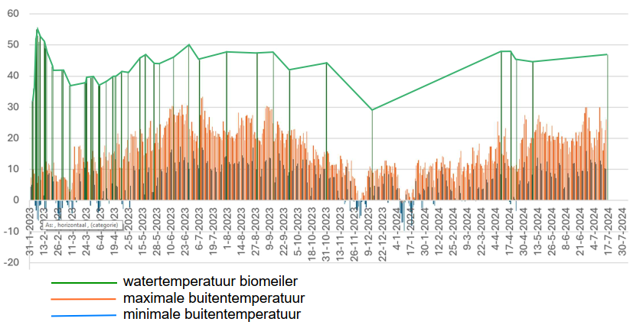
Results
Monitoring temperatuurverloop:
31 january 2023: Construction day
5 february 2023: 52 °C. Opening mixing valve
6 february 2023: 55 °C.
1 march 2023: 42 °C. Tap turned off,
8 march 2023: 37 °C. Start extra water
30 march 2023: 40 °C. Leak in the lower ring, the ring is disconnected.
17 april 2023: 40 °C. 0,75m3 chicken manure applied in a ring at the top.
17 may 2023: 47 °C.
summer 2023: +- 45 °C. maximum power 1 kW otherwise the temperature of the biomeiler will drop.
12 december 2023: 29 °C. Mixing valve closed. Expected end of biomeiler.
9 april 2024: 48 °C. 😊
18 april 2024: 48 °C. Mixing valve open, 1kw
8 may 2024: 44 °C. Mixing valve closed
16 june 2024: 47 °C.
temperature water biomeiler
max outside temperature
min outside temperature
www.twickel.nl 12

Slide 13
Results
Conclusions so far.
Water absorption of fresh poplar chips during filling is not enough (max 15%)
Adding 0,5% chicken manure accelerates composting and increases temperature. The postion of the chicken manure is good visible after a year.
Heat capacity (< 1KW) is limited with only fresh poplar wood chips. Not enough for heating (green)house.
The core temperature is 47 °C 20 months after construction. Without heat release.
The volume of biomass has decreased 35%, 20 months after construction.
The three goals (learning, composting, reducing Iron House energy consumption) have been achieved. Reducing energy consumption was minimal from the biomeiler heat, but more from the method of ventilation and heating the greenhouse. (Adjusting the central heating)
www.twickel.nl 13

Slide 14
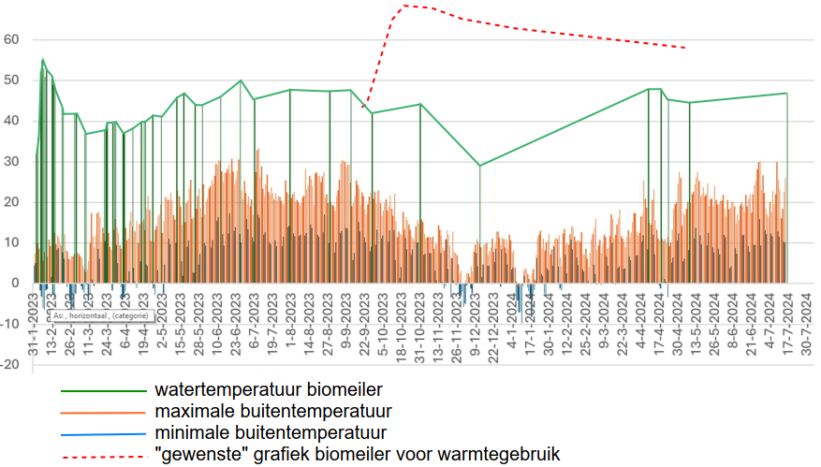
Results
Next steps
Empty and sift the biomeiler. Use coarse material for new filling, fine material fo the kitchen garden.
Refill the biomeiler with a new goal:
Provide sufficient heat (5-10KW) for 6 months during the winter
By adding leaves, twigs an manure (Nitrogen) to increase power.
By adding grass cuttings to retain water.
By simplify supply of water and air. (to increase temperature if necessary)
temperature water biomeiler
max outside temperature
min outside temperature
desired temperature biomeiler for heat use
www.twickel.nl 14

Slide 15
Recommendations
Gain a good understanding of the subject beforhand. Optionally, create a small test biomeiler first to gain experiens.
Set your goals. Do not build the first biomeiler for heat production.
www.twickel.nl 15

Slide 16
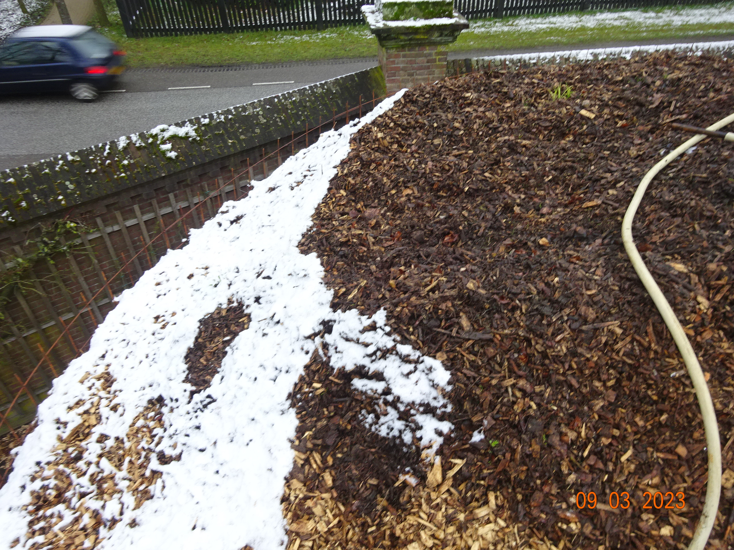
www.twickel.nl 16
25-05-2023: Sinked 30 cm

Slide 17
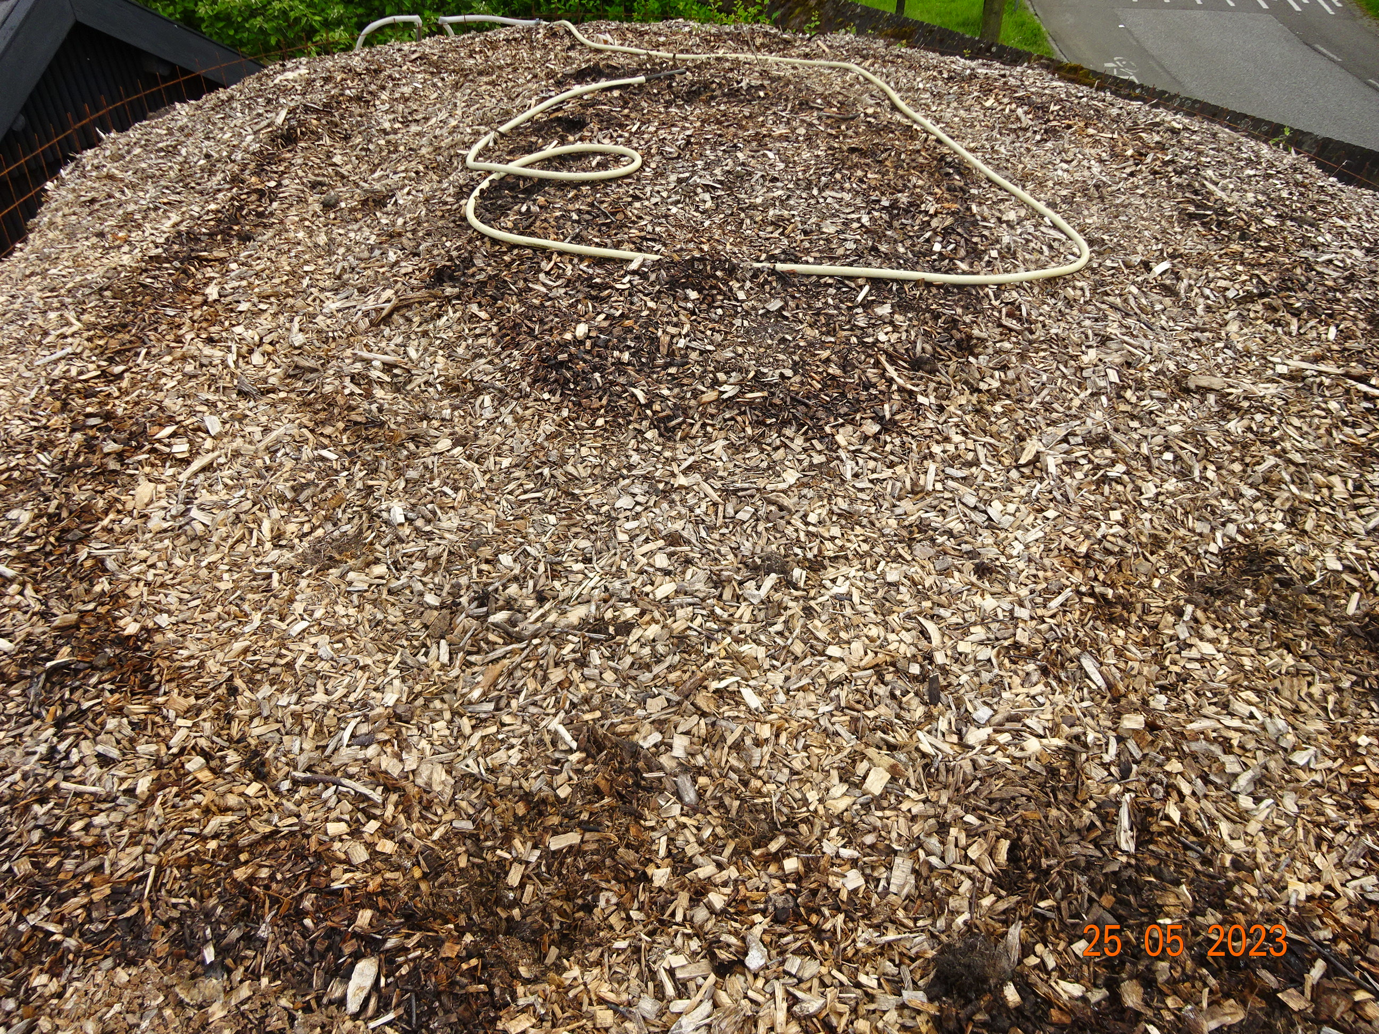
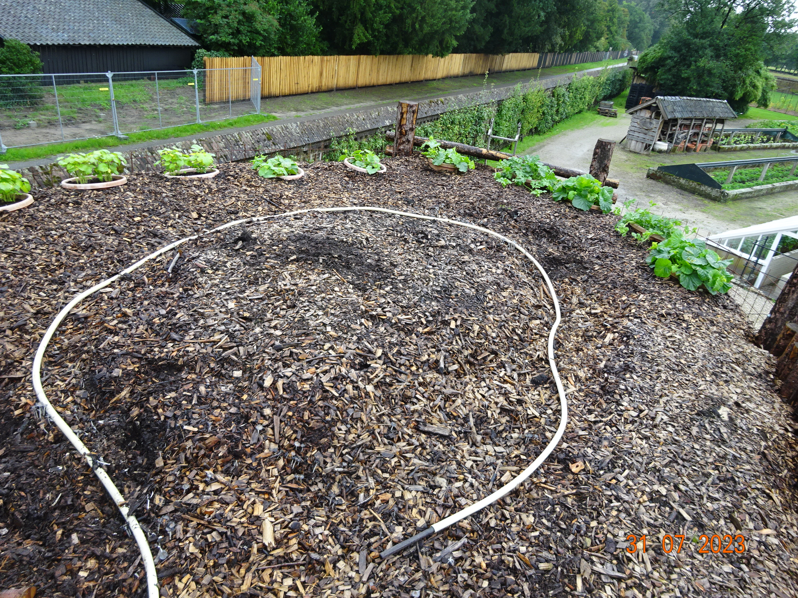
www.twickel.nl 17
31-07-2023 position chicken manure sinks faster

Slide 18
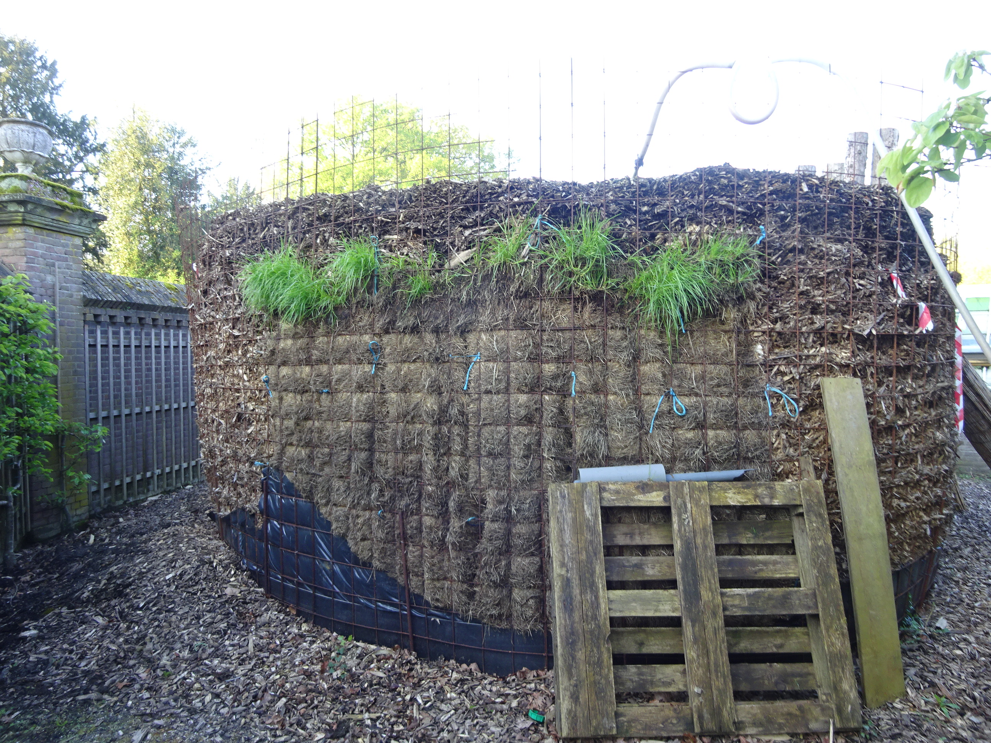
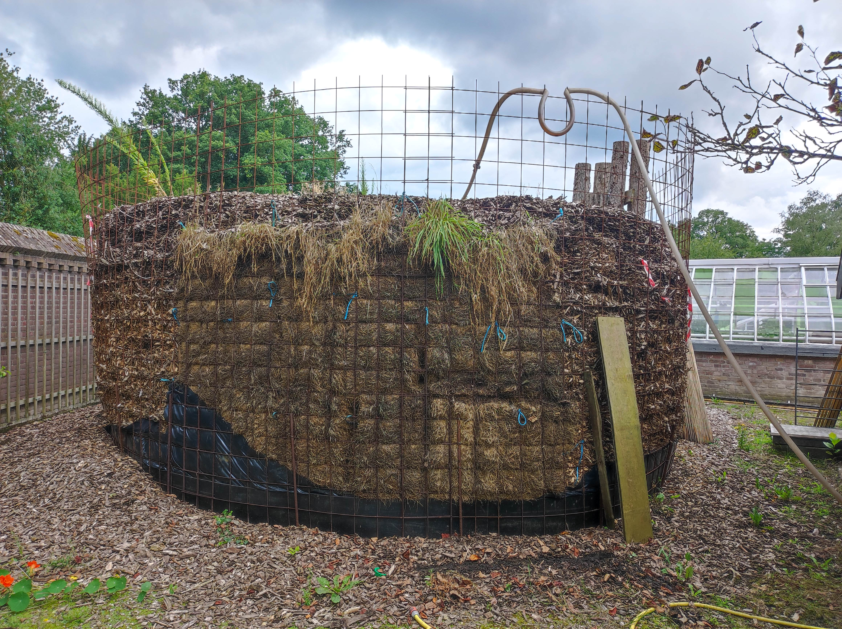
www.twickel.nl 18
16-07-2024 Sinked 100 cm

Slide 19
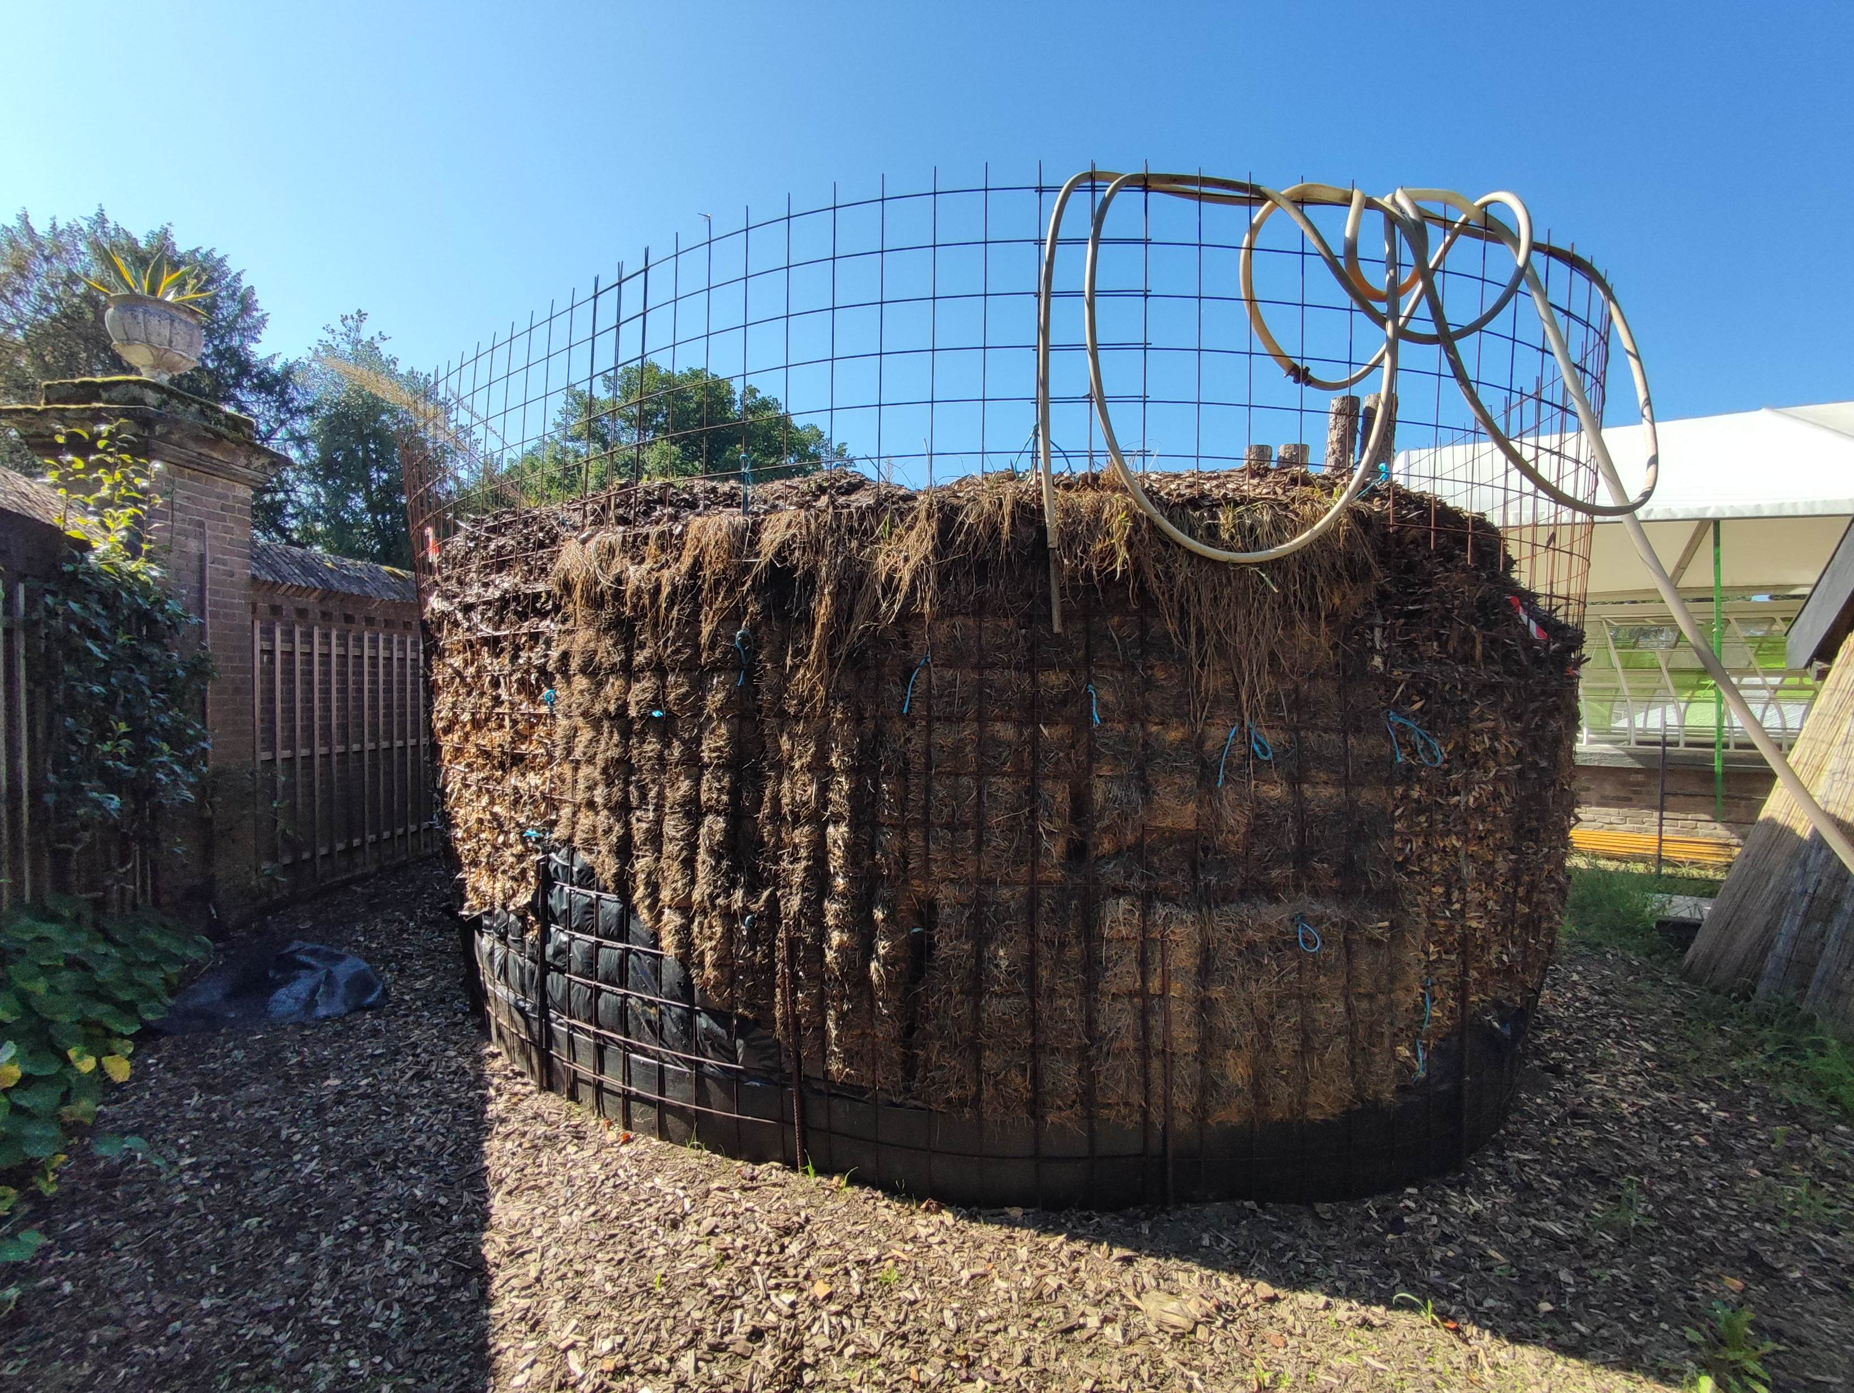
www.twickel.nl 19

