Slide 1
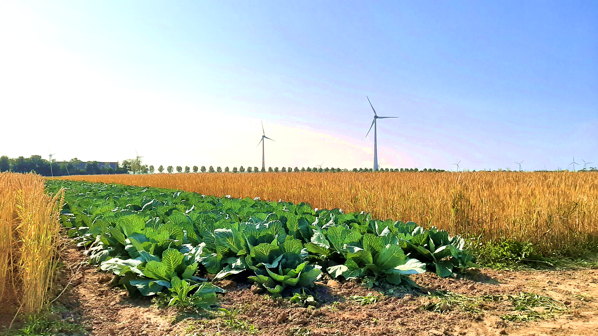
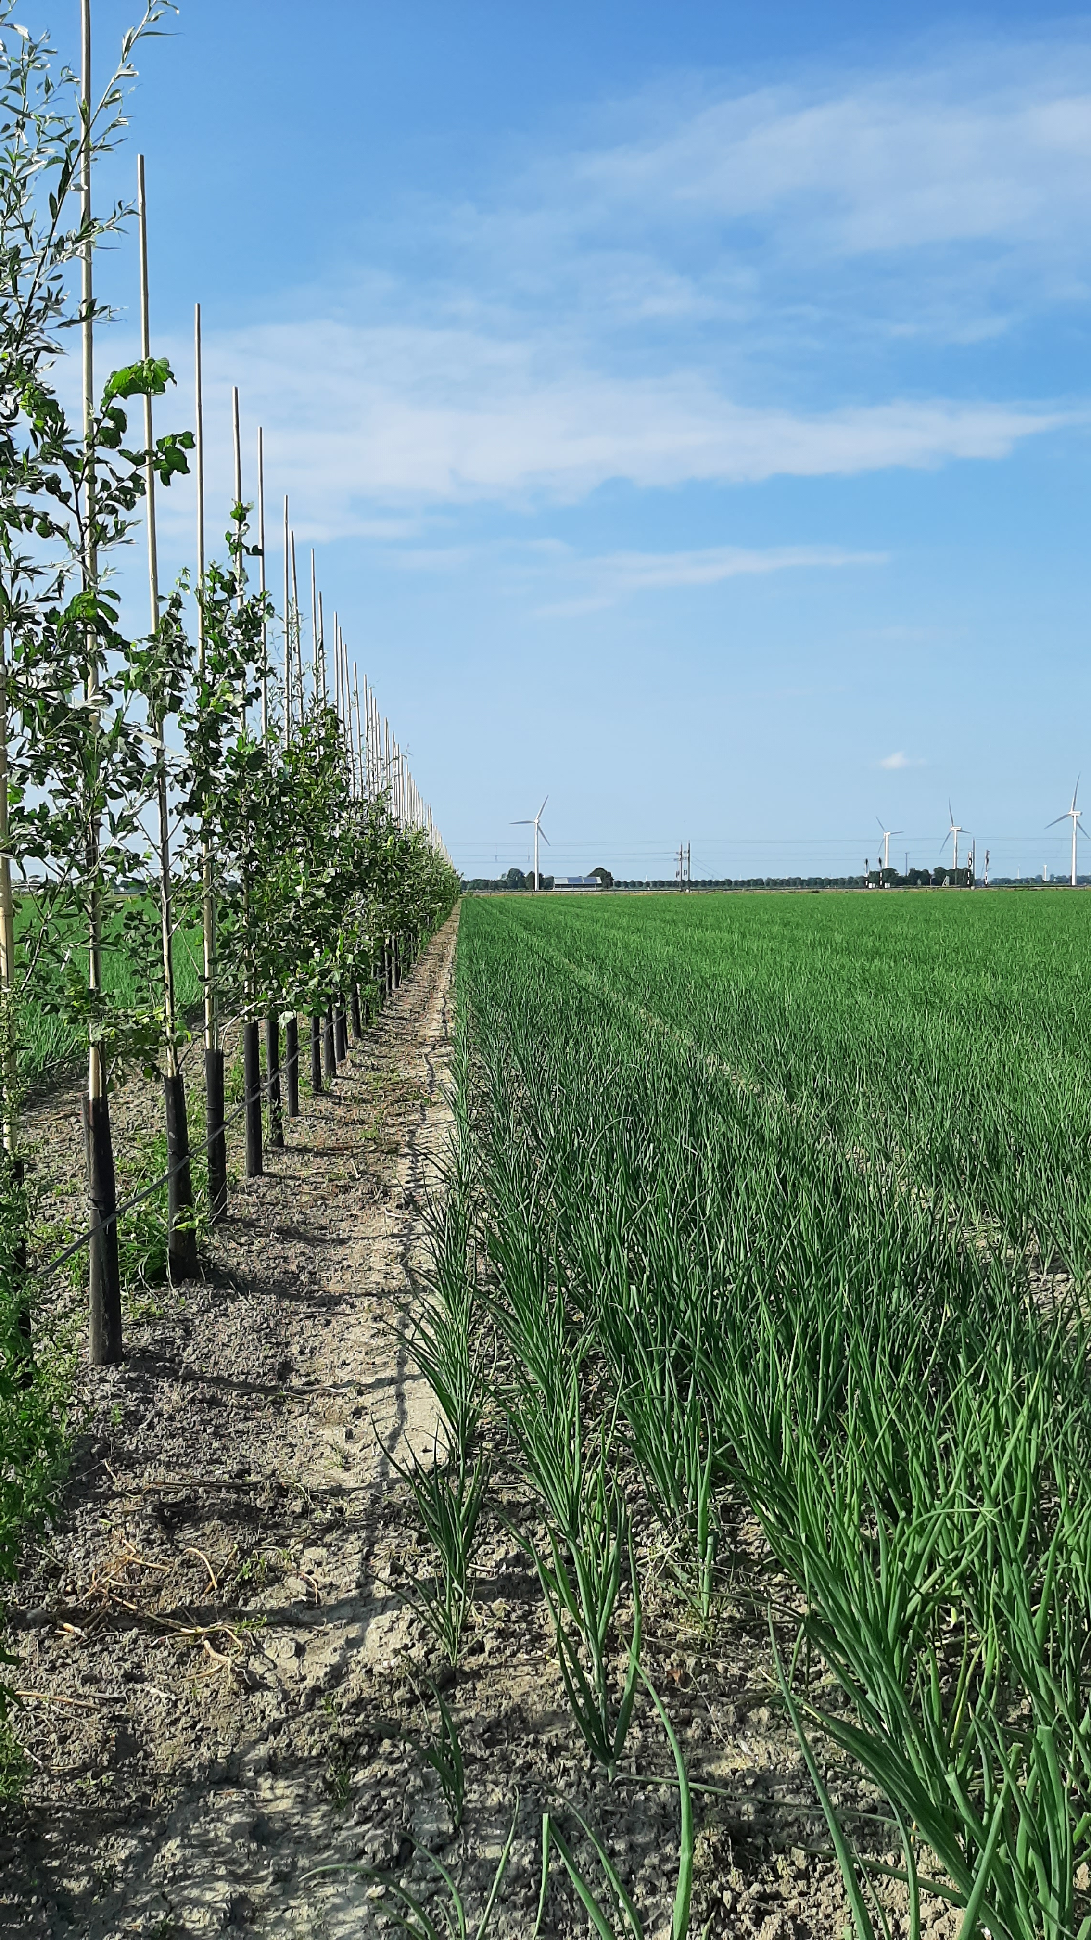
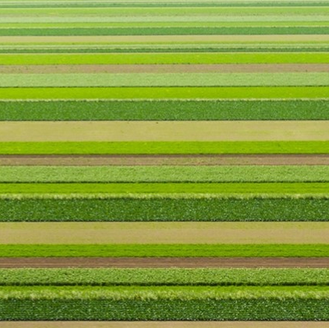
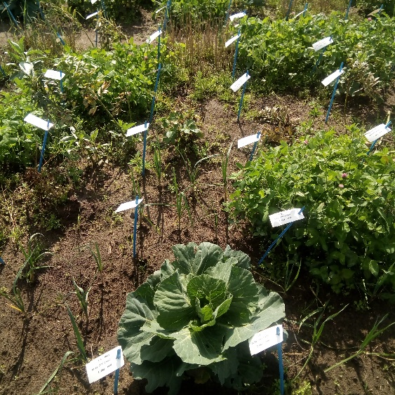


Making smart use of diversity
Dirk van Apeldoorn
Crop Systems Analysis and Farming Systems Research 5-9-2024
Notes:
Senior scientist cropdiversity, integrating best of science of the university with the best farmers of Wageningen Research.
Programme leader on transition Dutch agriculture to ecology based

Slide 2
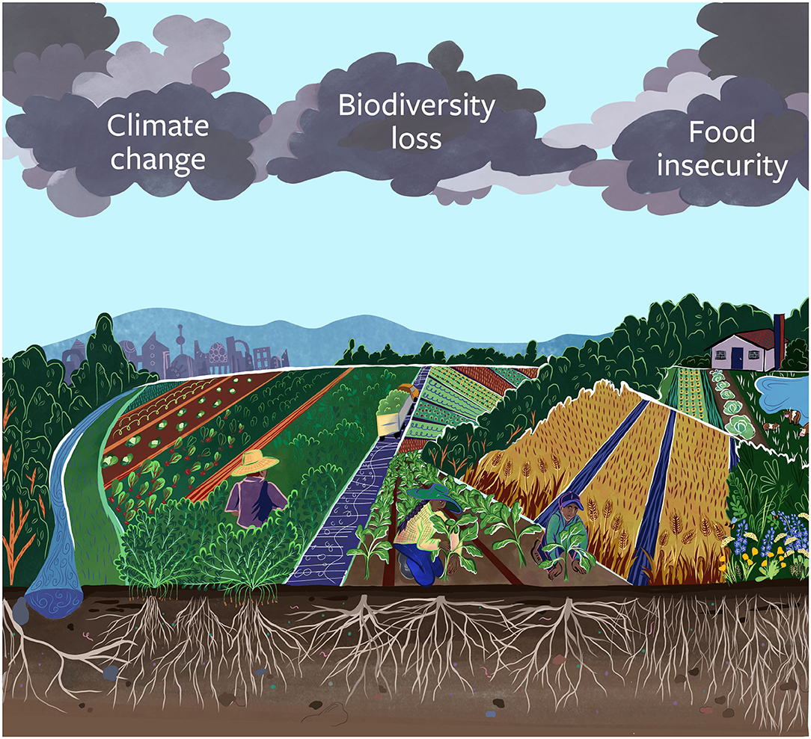
Dark clouds on the horizon of agriculture
The Anthropocene “triple threat”, agriculture should:
-Provide healthy diets to many
-deal with a changing climate
-be nature positive
Petersen-Rockney (2021) https://doi.org/10.3389/fsufs.2021.564900
Notes:
We cannot continue as we have done in the past just doing things better will not solve this poly crises, we need to things differently

Slide 3
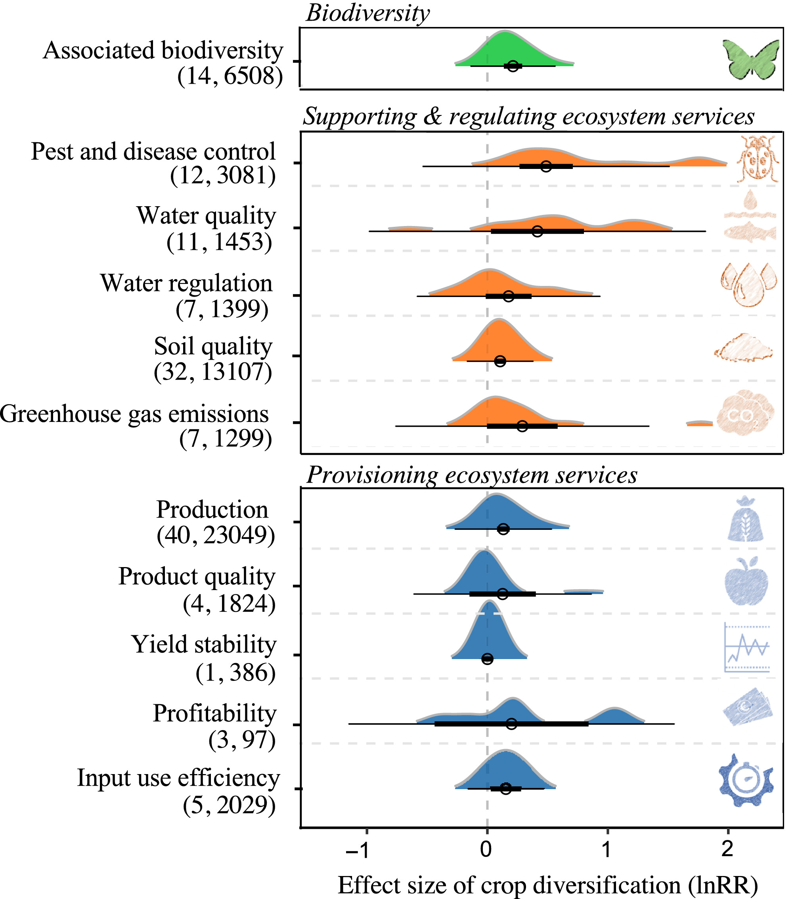
Cropdiversity as lever for change
Huge variation
No ‘silver bullet’
Context dependent
Design is needed
Based on:56439 experiments, 95 Meta-analyses
Beillouin et al. (2021) doi: (10.1111/gcb.15747)
Notes:
Promising avenue is crop diversification, there is overwhelming evidence of the multiplie benefits of cropdiversity. In general positive effect but huge variation. Combining all ES is a challenge.
Explanation of graph. X axis is LN(mixture/reference). So LN(1/1)= 0 = no difference with reference. Doubling of effect LN(2)=.7, 50% better is .4

Slide 4
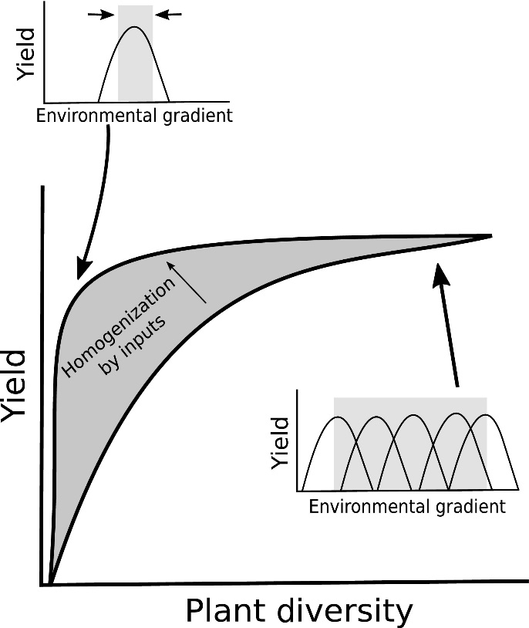
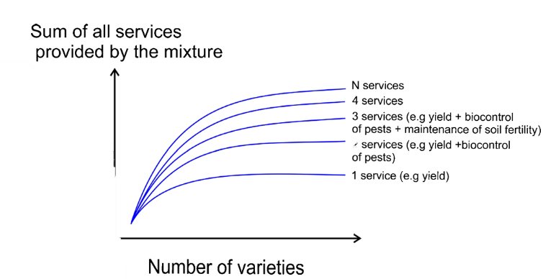
Ecology based agriculture
Forest et al (2017).
doi:10.1111/1365-2745.12789.
Barot, et al. (2017).
doi.org/10.1007/s13593-017-0418-x
Notes:
In the past agriculture research focussed on removing diversity. Farmers tried to mimic ag. Research stations by trying to get the same conditions everywhere by plowing fertilizing, breeding etc. However we are now faced by a need to reduce this external control why becoming more robust.
By making smart us of Diversity we can make better use of heterogeneous environments. so not trying to reduce diversity but to enhance it.

Slide 5
What kind of diversity is needed?
Step->
Genes
Time
Space
Ditzler et al., (2021)
doi: 10.1016/j.eja.2020.126197
Notes:
What is diversity, we often think of just many species but figure shows same diversity but in different dimensions but logically each has different effects.

Slide 6
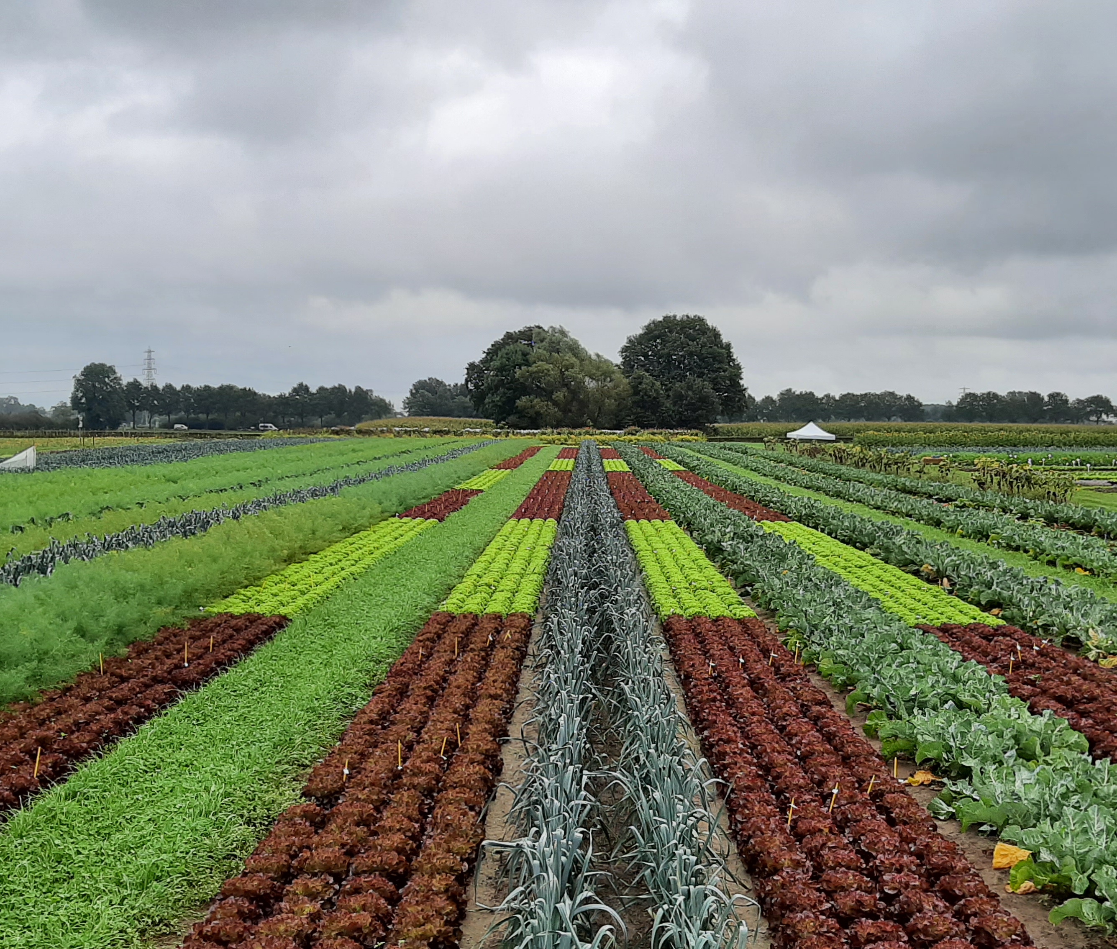
Genes
Mixed farming
Cultivars Crops Components
Crop mixtures
Cultivar mixtures
Notes:
First dimension of genetic diversity show effects of different scales of genetic diversity

Slide 7
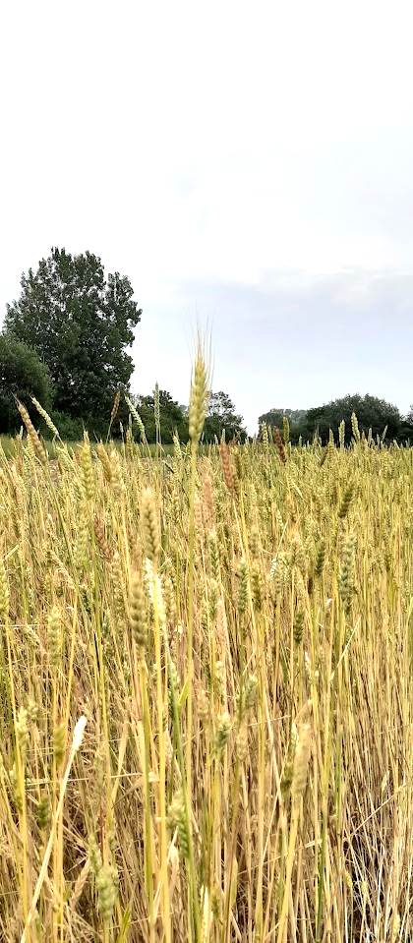
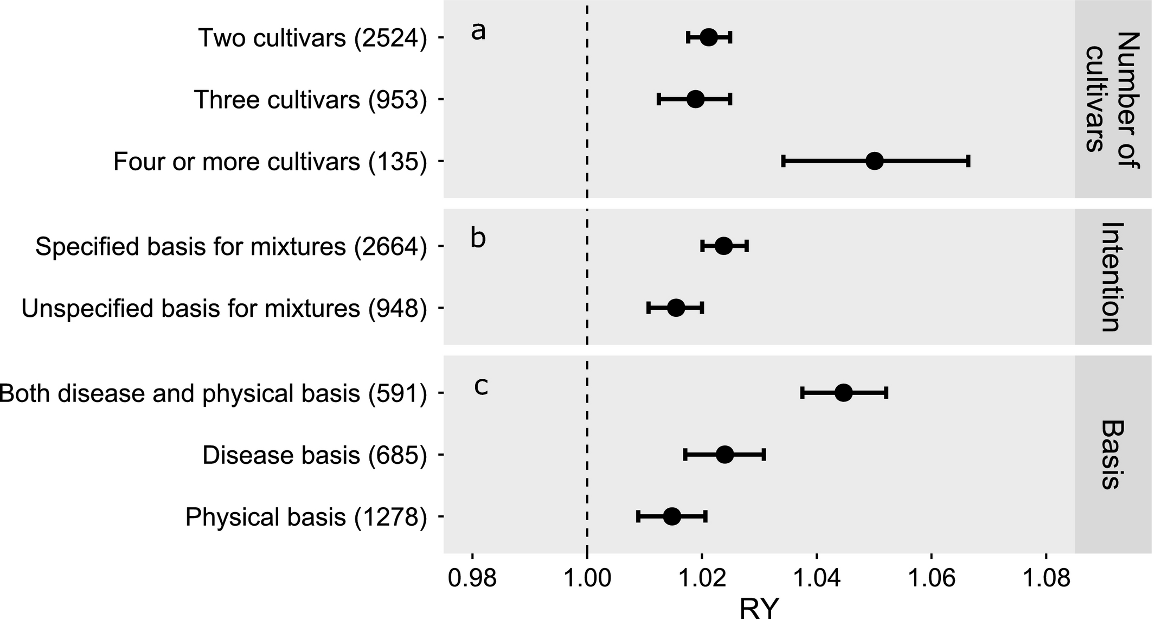
Genes: cultivar mixtures
Reiss et al. (2018) DOI: (10.1002/eap.1629)
Notes:
Easiest, change nothing only number of cultivars. You might have experience with heirloom varieties that are less predictable. Difficult to make decisions limited gains

Slide 8
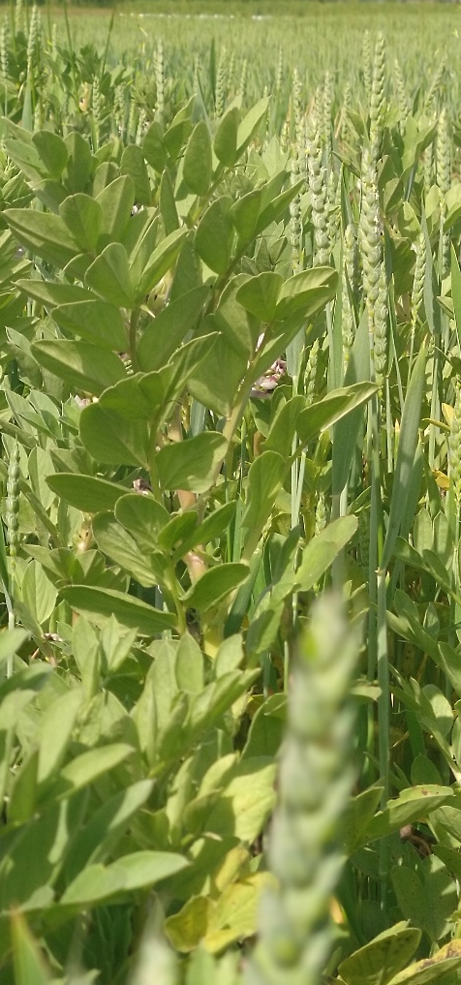
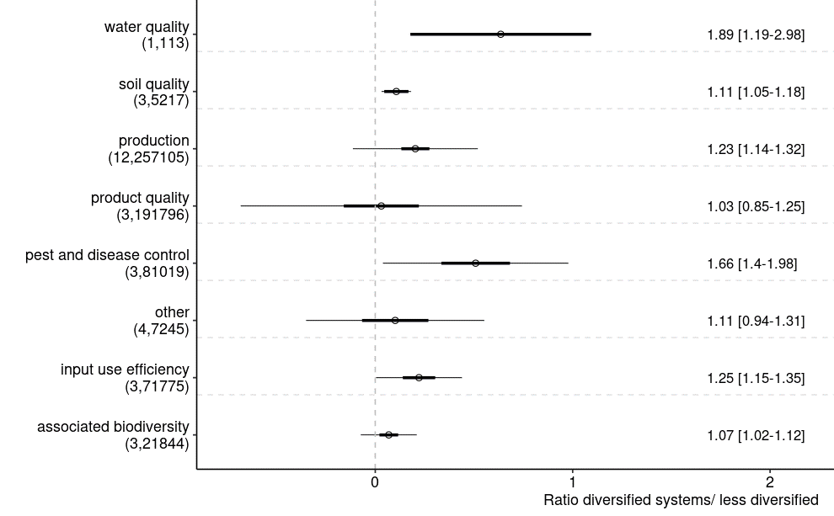
genes: intercropping more species
Beillouin et al. (2021) doi: (10.1111/gcb.15747)
Notes:
Mixing species, more effective large effect on disease control. Again explain graph. Open circle is estimate of the mean. Thick bar (95 CI of mean) thin bar is 95 % distribution of complete population. So if you would start mixing species there is a 95% change that your system would fall within this range.

Slide 9
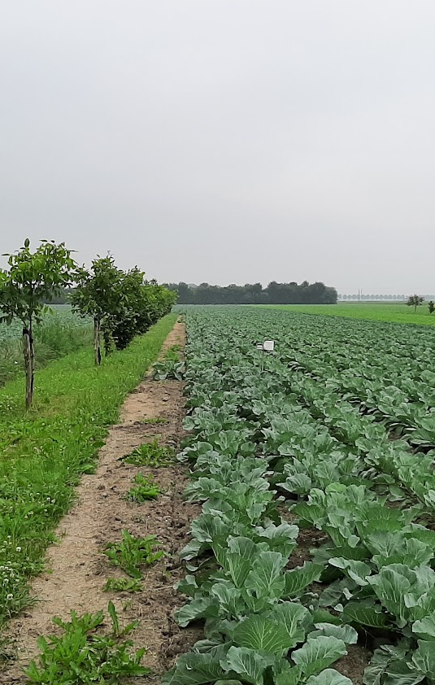
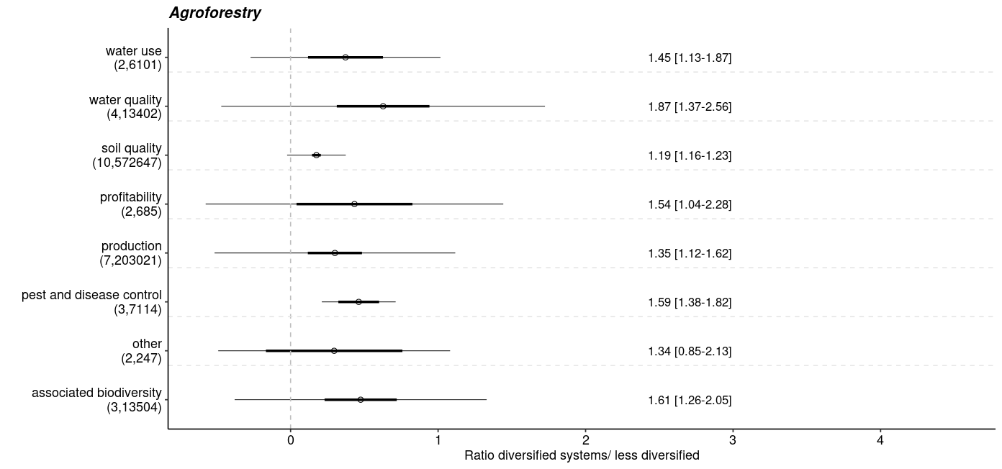
Genes: agroforestry adding components
Beillouin et al. (2021) doi: (10.1111/gcb.15747)
Notes:
Adding components largest effects of diversity, biggest challenge is to find market of all components

Slide 10
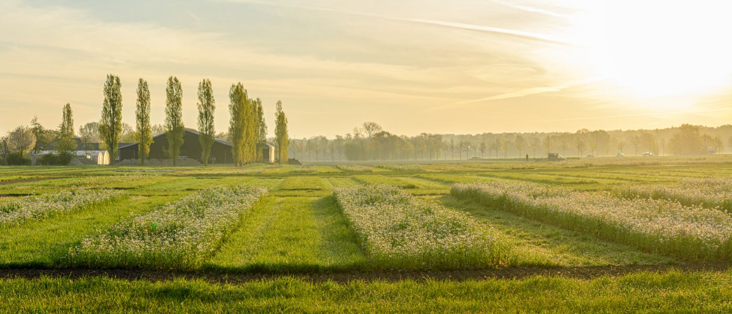
Time: asynchrony
Relay intercropping
Cover crops
Crop rotation
Days season years
Notes:
Different scales of temporal diversity

Slide 11
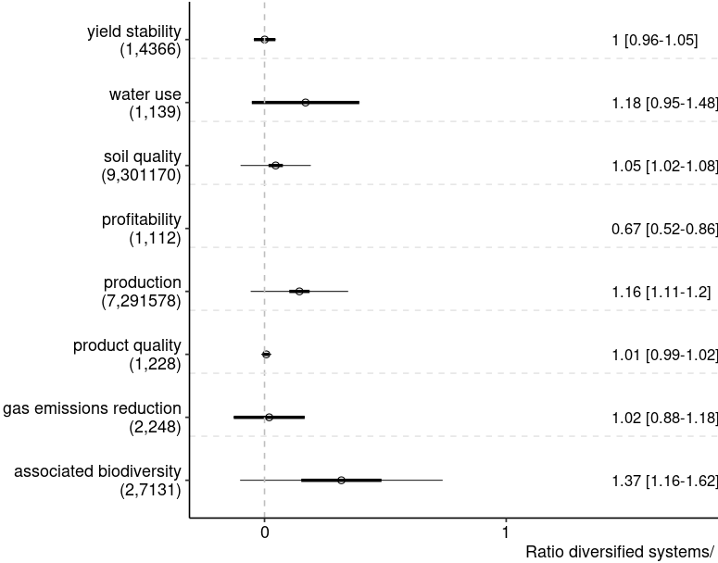
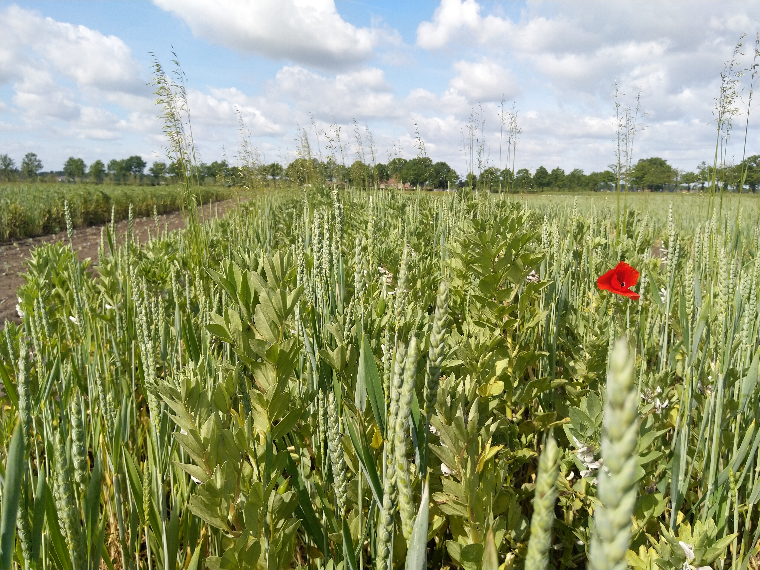
Time: crop rotations
Beillouin et al. (2021) doi: (10.1111/gcb.15747)
Notes:
Easiest crop rotation (each year other crop) limited effect, except biodiversity positive and profitability very negative (average 33% ) loss. Makes sense on the short term, most profit if you could only grow your most profitable crop

Slide 12
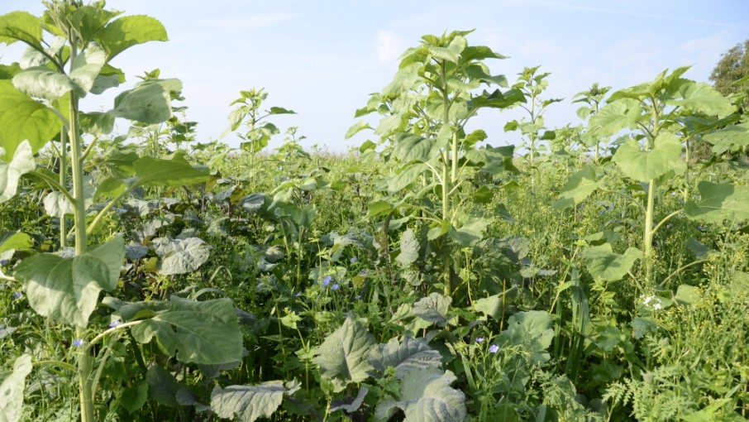
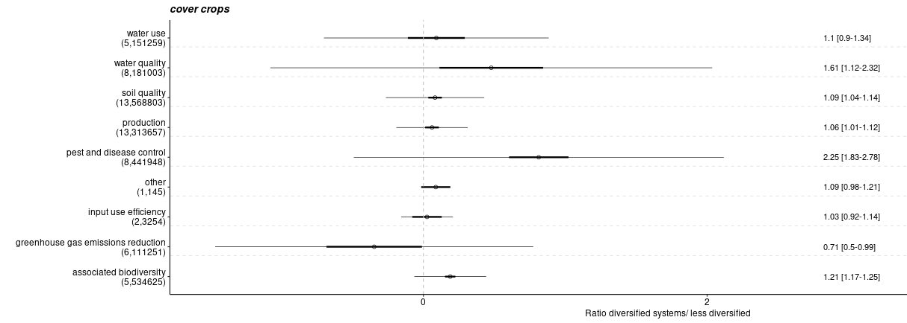
Time: covercrops
Beillouin et al. (2021) doi: 10.1111/gcb.15747
DSV zaden
Notes:
keep the soil covered! Huge effect on pest and diseases more than double reduction. Covercrops feeds the soil foodweb. Increase of GHG due to rotting plants.

Slide 13
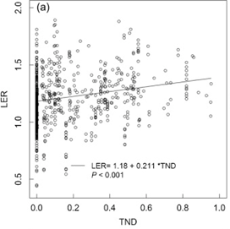
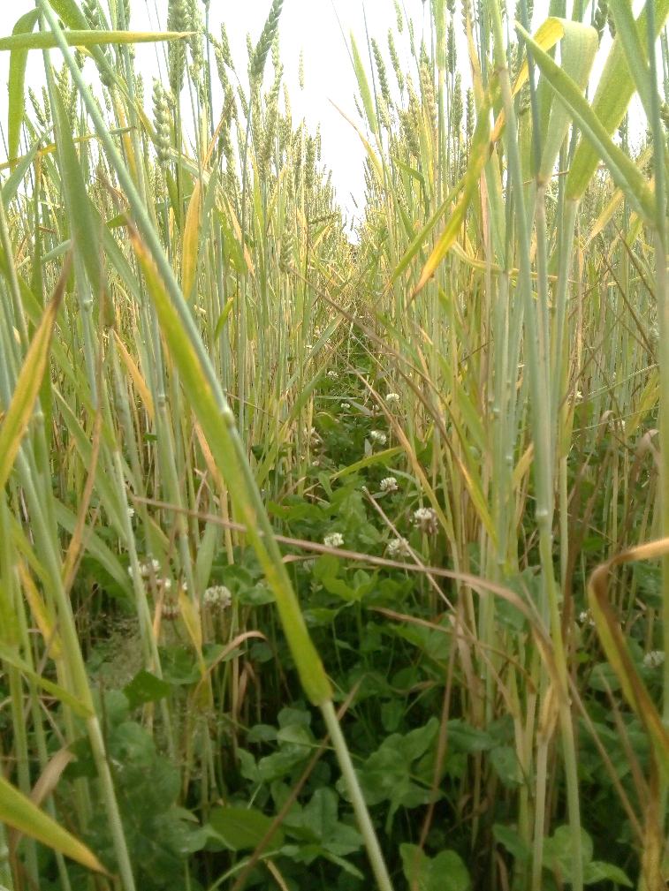
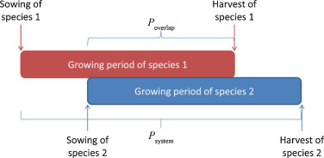
Time: relay intercropping
Yu et al., (2015)
http://dx.doi.org/10.1016/j.fcr.2015.09.010
Notes:
Double use of the season. Theoretically most productive increase in temperate regions. By starting to grow already one crop while the other one doesn’t need all the light. In the graph at 0.0 if you sow two species at same time yield is 18% higher. With 50% overlap benefit is ~30%

Slide 14
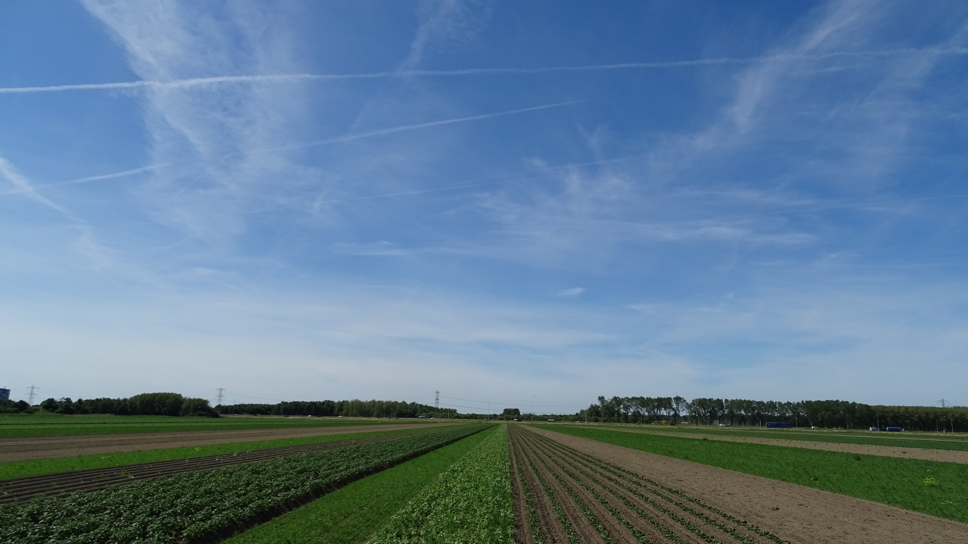
Space: heterogeneity
Semi-natural habitat
strips
pixels
ha m² cm²
Notes:
Final dimension, different scale of spatial diversity

Slide 15
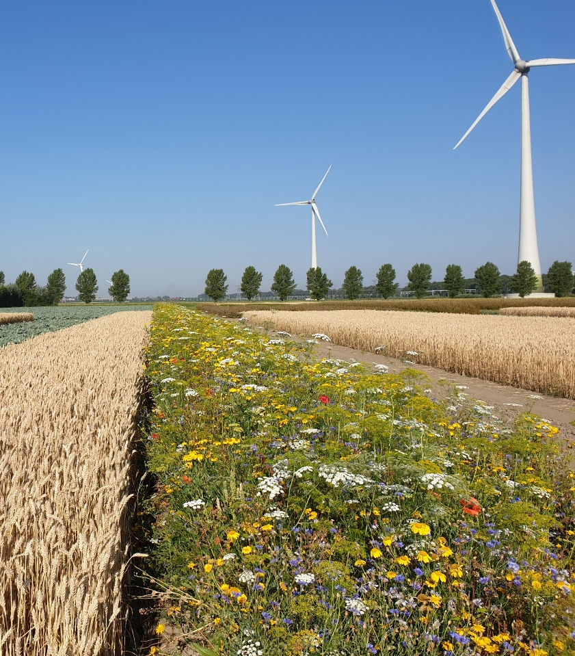
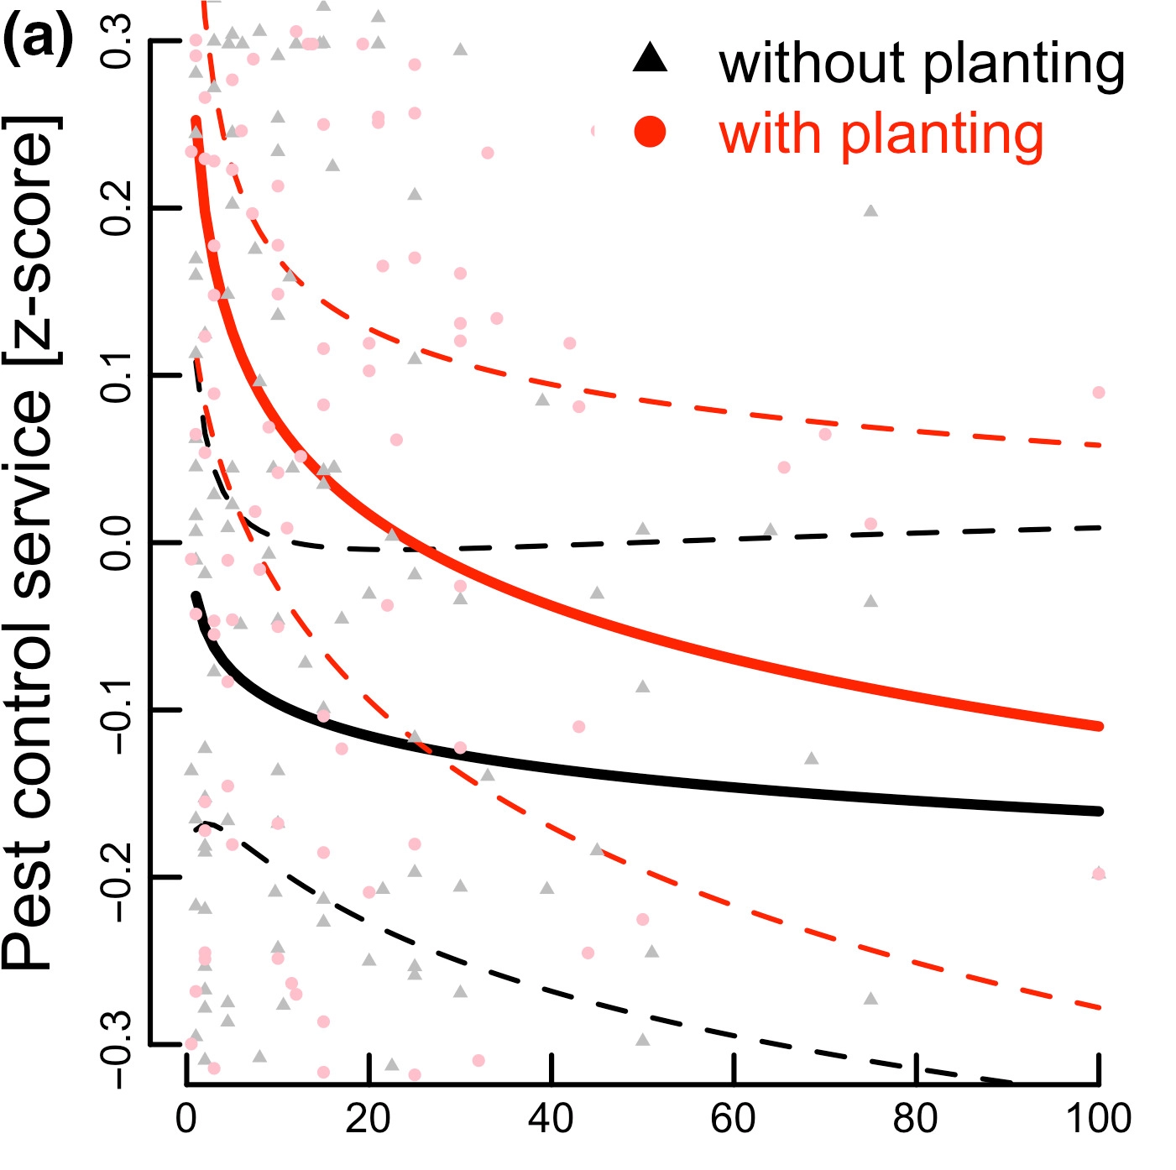
Flowerstrips: Pest control declines exponentially with distance
Albrecht et al., (2020) doi: 10.1111/ele.13576
Fogelina Cuperus
Notes:
Well known use of flower strips attractive but not so effective. Y axis is how different pest control from no strip, control is edge of field without planting. After 20m same effect as edge without flowers.

Slide 16
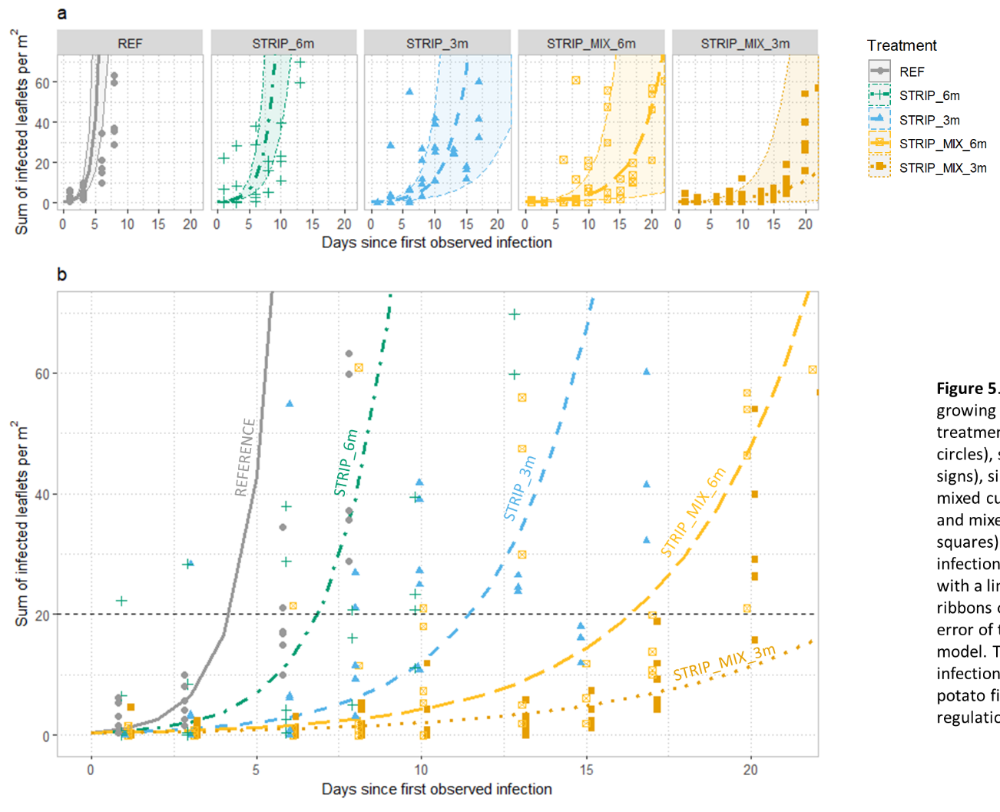
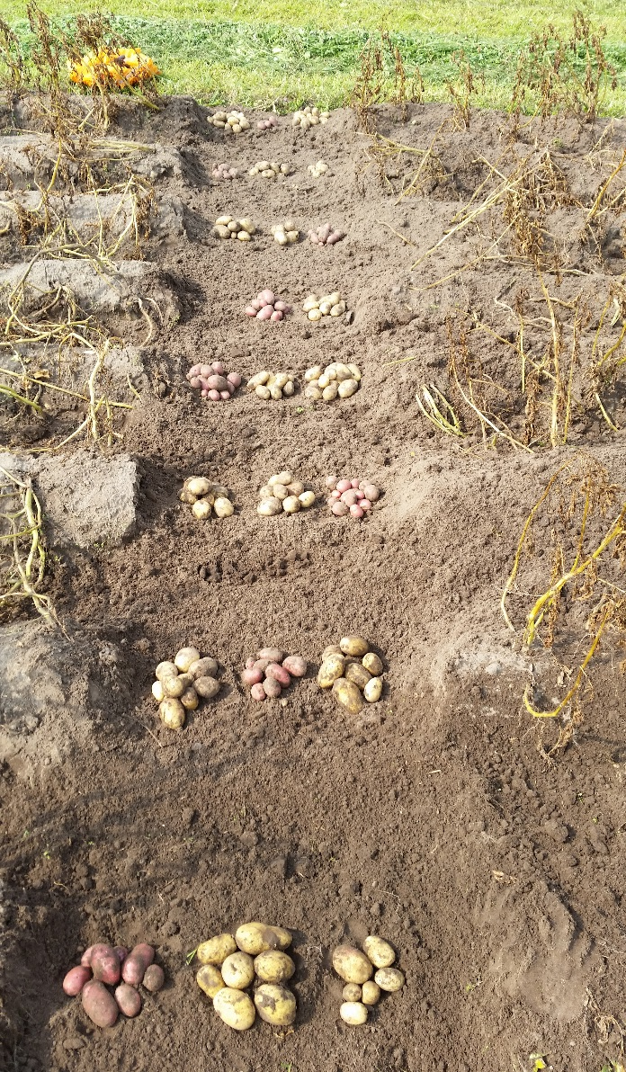
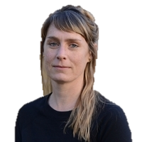
'Flattening the curve'
Lenora Ditzler
https://doi.org/https://doi.org/10.1016/j.eja.2020.126197
Notes:
Strip cropping is social distancing, diseases can not easily spread. Here case of potato late blight. 3m wide strips reaches control limit (20 leaflets) a week later than control. Further increasing distance by including resistant varieties more than 3 weeks. Important! don’t mix varieties the change of breaking resistance is too big! Replace different varieties by different species

Slide 17
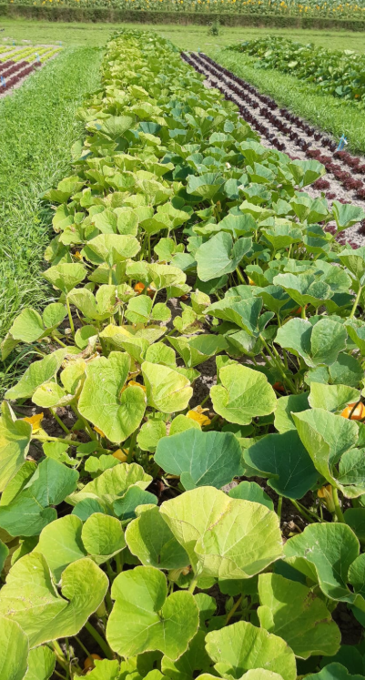
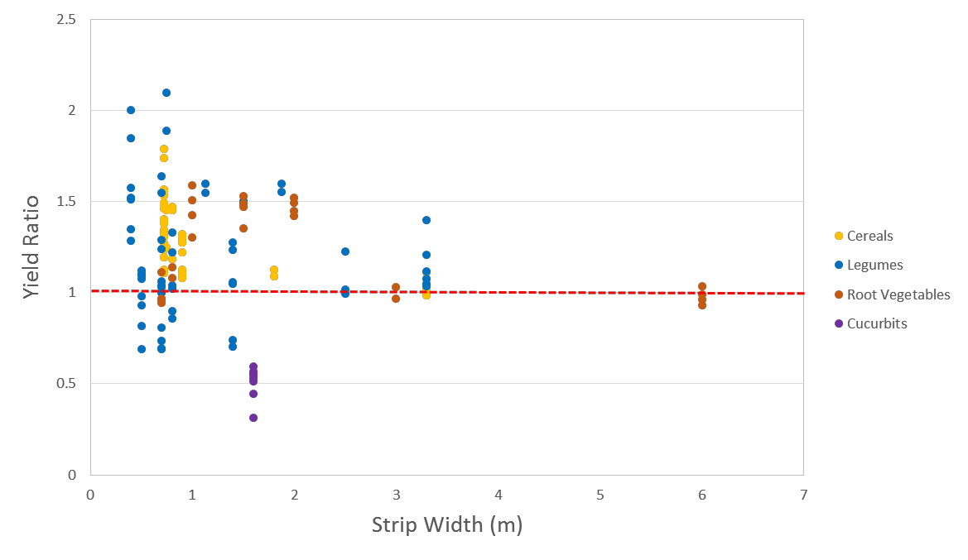
Space: plants need to interact to benefit
Notes:
Here in this graph you see that yield benefits mostly occur in narrow strips. In the picture you see pumpkins left next grass clover and right next to lettuce.

Slide 18
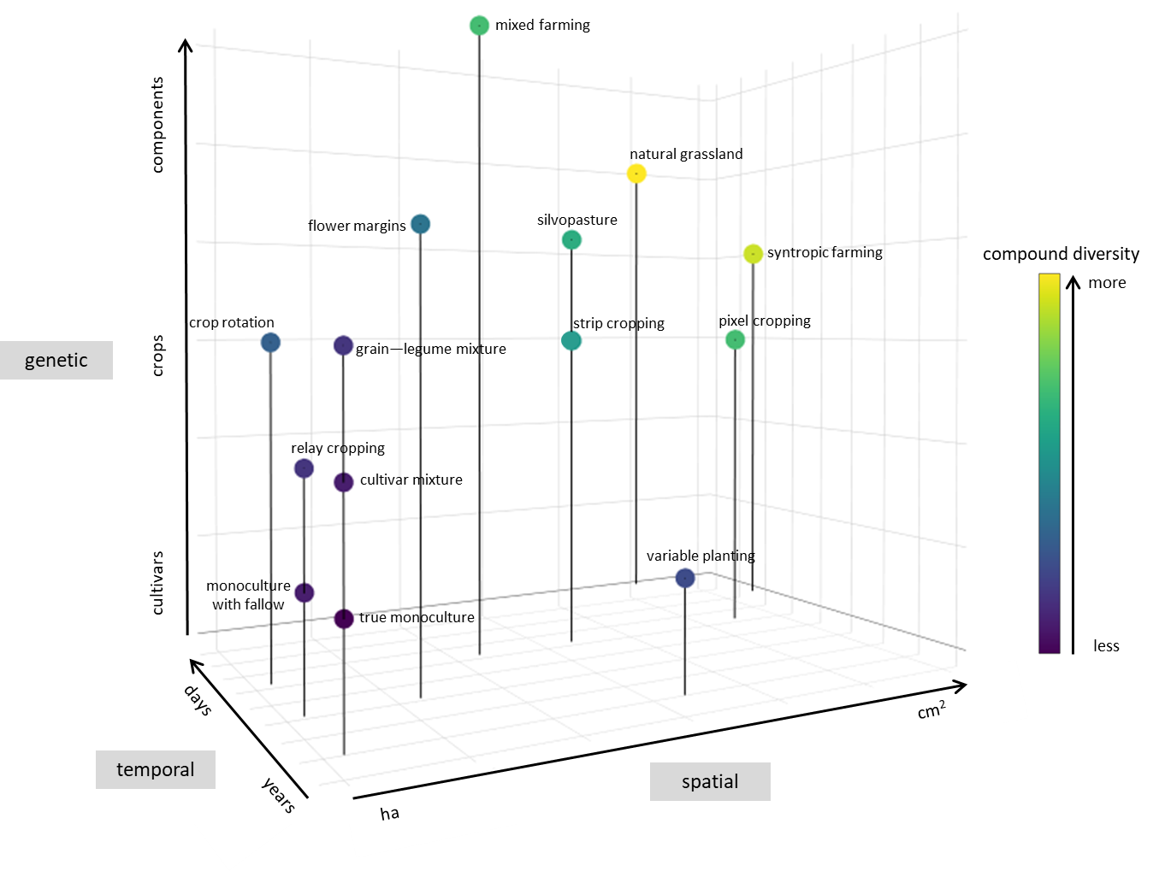
Bringing it to practice
Ditzler et al., (2021)
doi: 10.1016/j.eja.2020.126197
Notes:
Summarizing very complex especially since you can combine it. Here with made a 3D cube categorising different practices and how divers different systems are. Now task to find the trade-offs

Slide 19
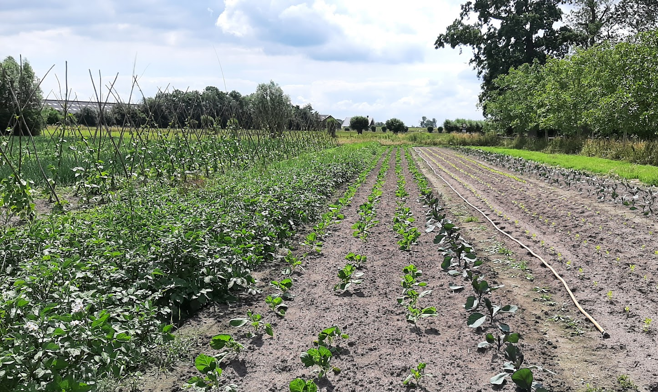
From simpel->labour efficient
Notes:
What you can do easily, break up your blocks in smaller beds

Slide 20
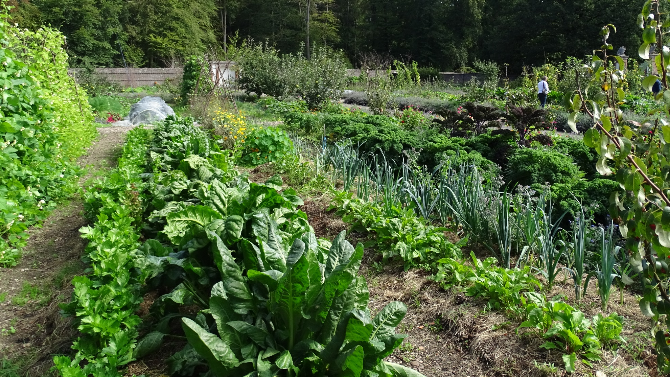
To more complex: labour intensive
Notes:
Including different species in one bed results in pest control and double yield, planning is a challenge and you can only work per row

Slide 21
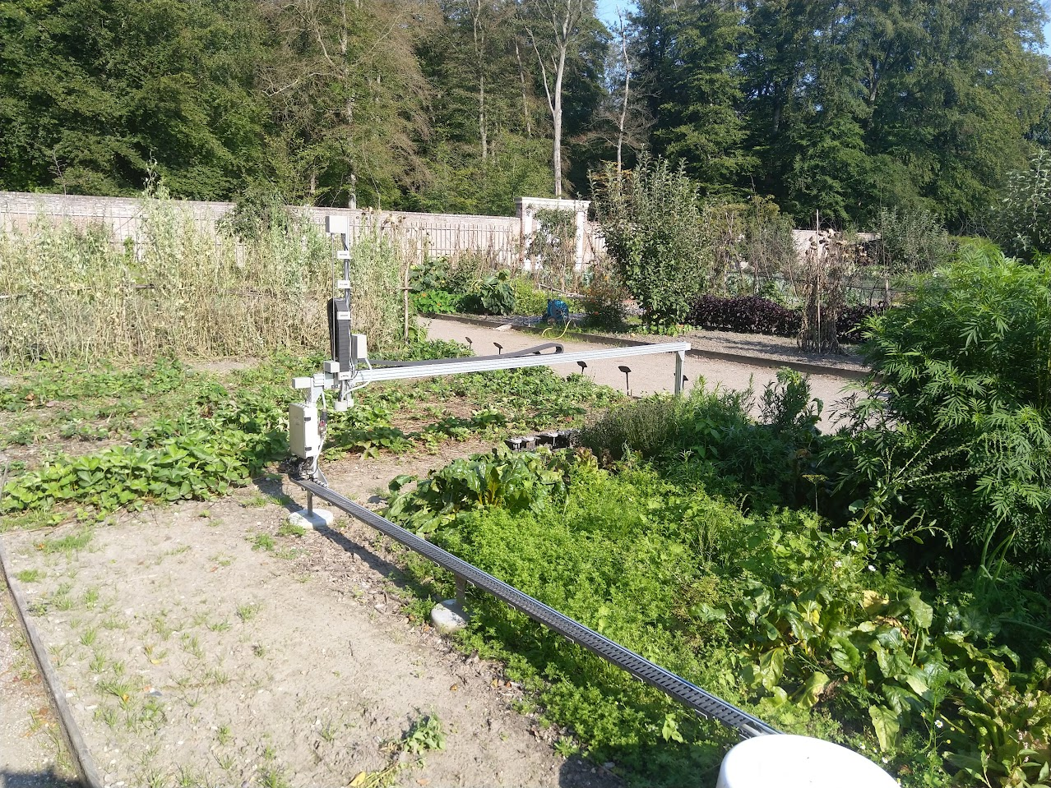
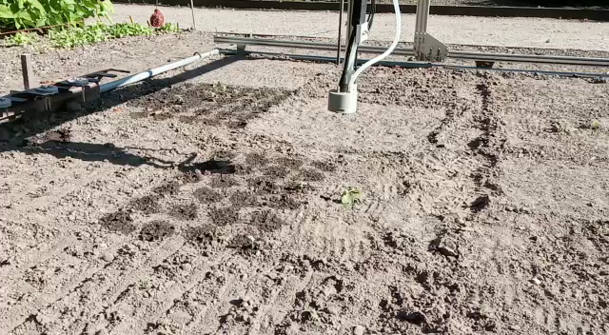
To(o) complicated:
Notes:
What we tried is pixel cropping. Manage each plant individually. Works very well for ecology, agronomy was challenging, technology was a disaster

Slide 22
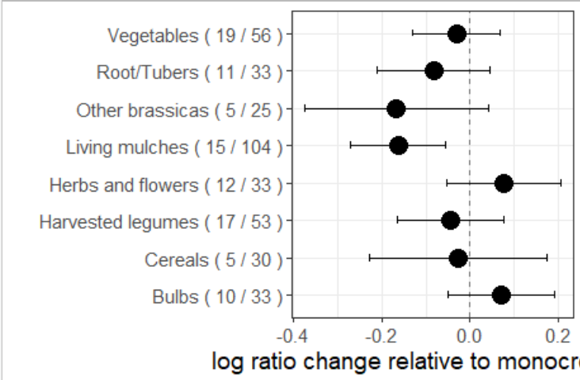
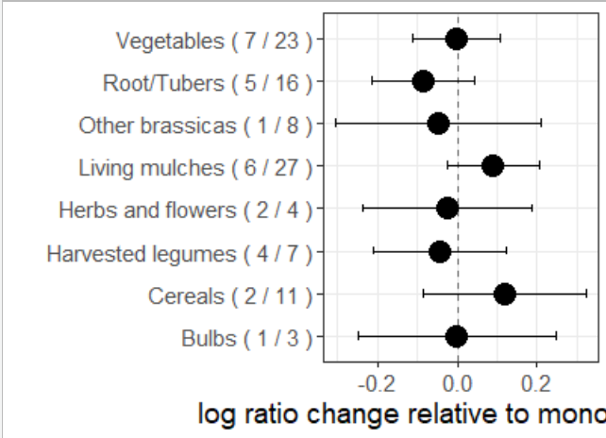
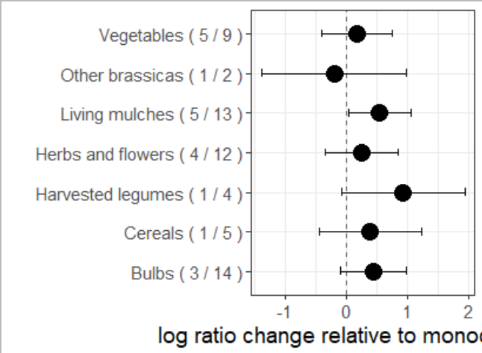
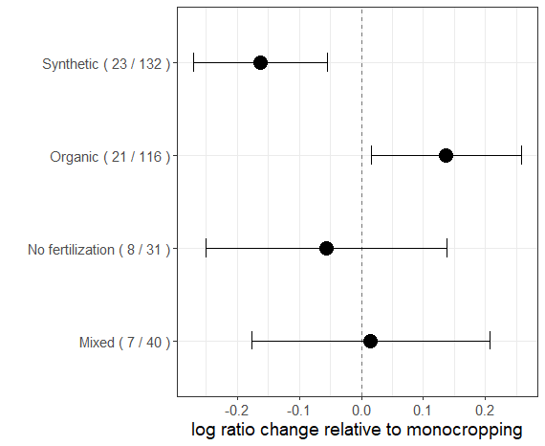
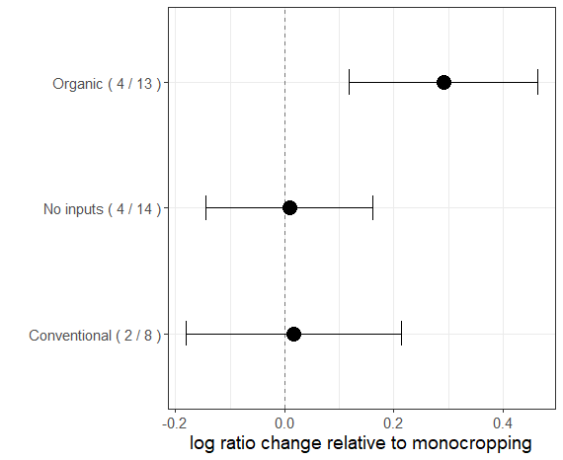
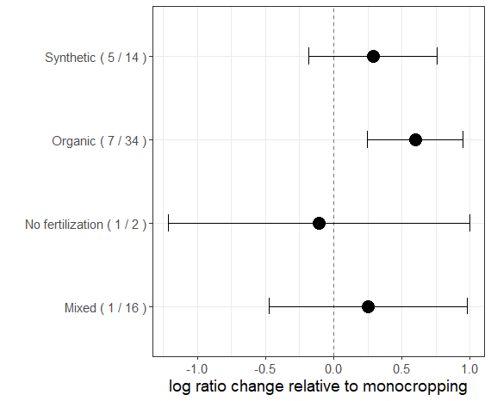
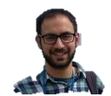
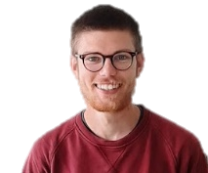
There is no best neighbour, context matters
Productivity
Product Quality
Marketabillity
Pest injury
Agronomic classification
Type of pesticide
Type of fertilizer
Javier Carrillo & Titouan Le Noc
10.1016/J.AGEE.2023.108564
Notes:
Work we did in cooperation with Zuylenstein to find best neighbours for cabbage. So we could make use of best neighbour . Surprising message no best neighbours. Depending on objective and context different choices can be made. Here again all available scientific knowledge on intercropping cabbage. We find on average a negative effect of intercropping! But in organic systems very positive +50% pest control. And neighbours have different effect a yield reduction but less damage and better sorting

Slide 23
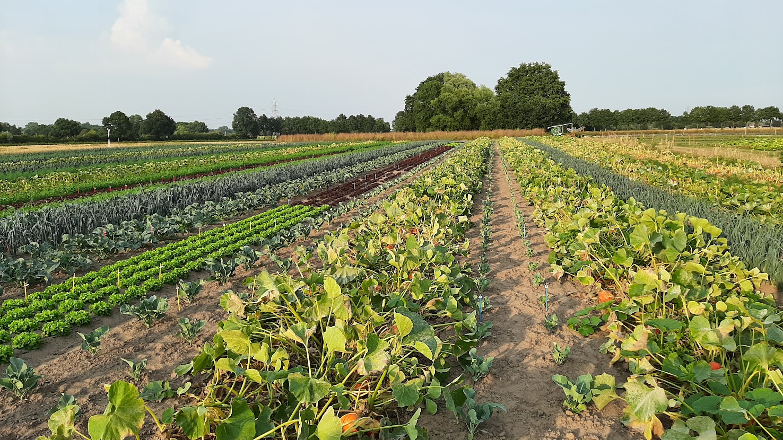
Diversity requires entrepreneurship and green thumb
Notes:
Diversity can be an asset by being able to cater to everyones need. Here picture of cauliflower between pumpkin, very bad, cauliflower between lettuce and pumpkin better, leek with lettuce best. Results in spread of yield .

Slide 24
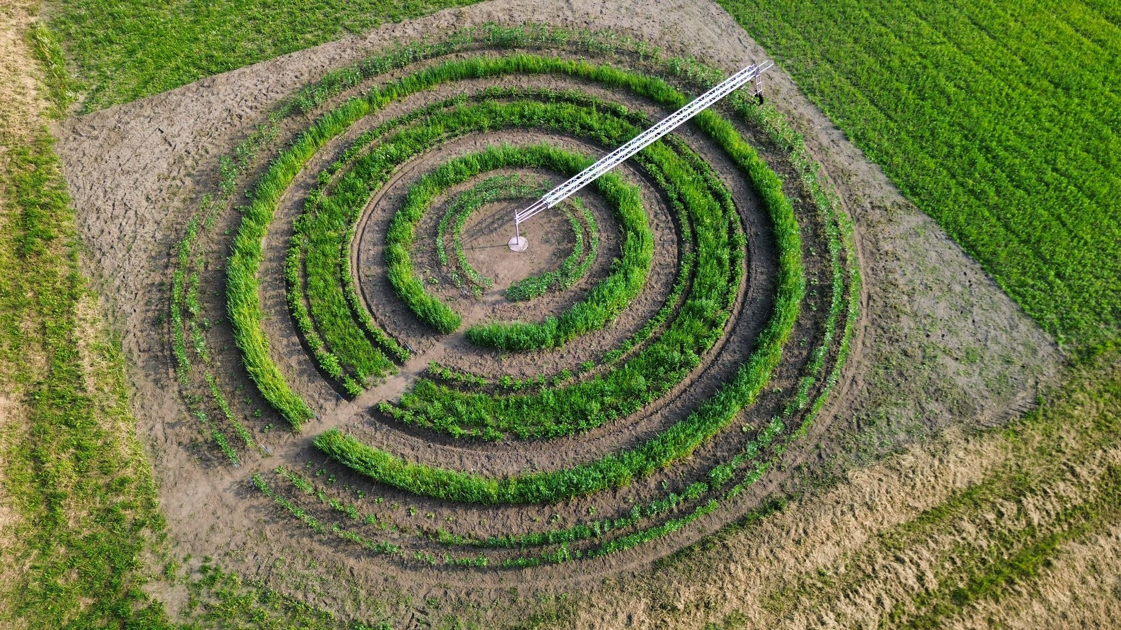
Diversity enables creativity
Notes:
Circle farming, diversity can openup new ways for agriculture beyond delivery of food. Including new people and reconnecting society with food and landscape.

Slide 25
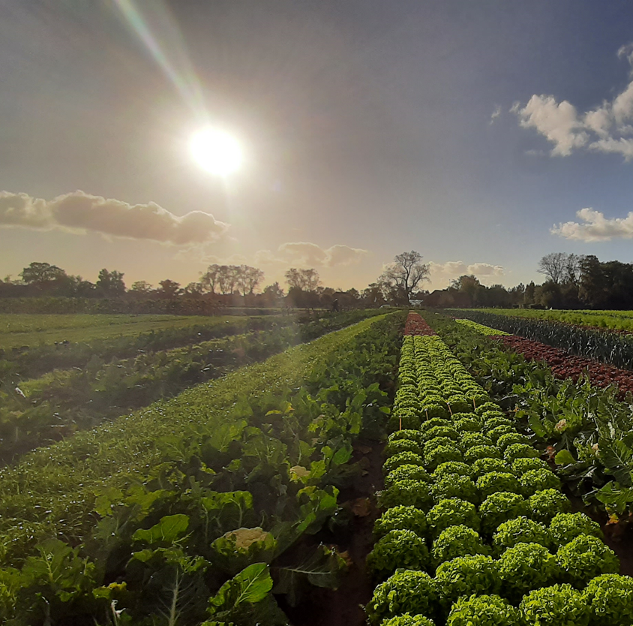
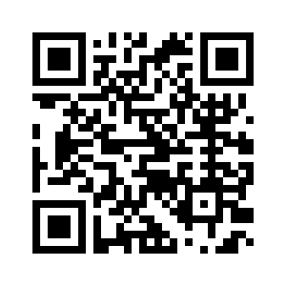
We need more diversity
We are in trouble
Diversity offers a way out
Embrace diversity
Thanks to:
Walter Rossing, Wijnand Sukkel, Laura Riggi, Luuk Croijmans Fogelina Cuperus, Stella Juventia, Hilde Faber, Titouan le Noc and many, many students
Dirk.vanapeldoorn@wur.nl
www.wur.nl/strokenteelt
#stripcropping

