Slide 1
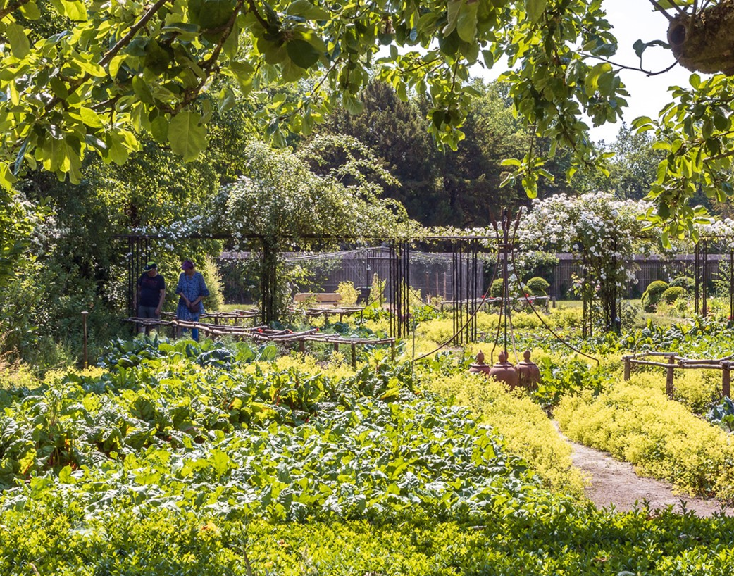
Two gardens, one vision
Futureproof and sustainable

Slide 2
The Questions
Can you tell us about..
your vision on the management of the kitchen gardens of Zuylestein and Twickel?
the exploitation of such kitchen gardens in terms of money and manpower?
Notes:
Now, before answering the first question, I’ll start with the numbers and the current exploitation.

Slide 3
The numbers
Total ca 7.000 ha
50% agricultural land
50% forest and nature reserves
2 monumental parks in English style
Lage en
Brecklenkamp
500 ha
Twickel
4.300 ha
Nettelhorst
114 ha
Zuidwijk en Santhorst
220 ha
Hof te Borculo
Zuylestein
156 ha
Hof te Dieren
1.000 ha
Geldersche Waard
300 ha

Slide 4
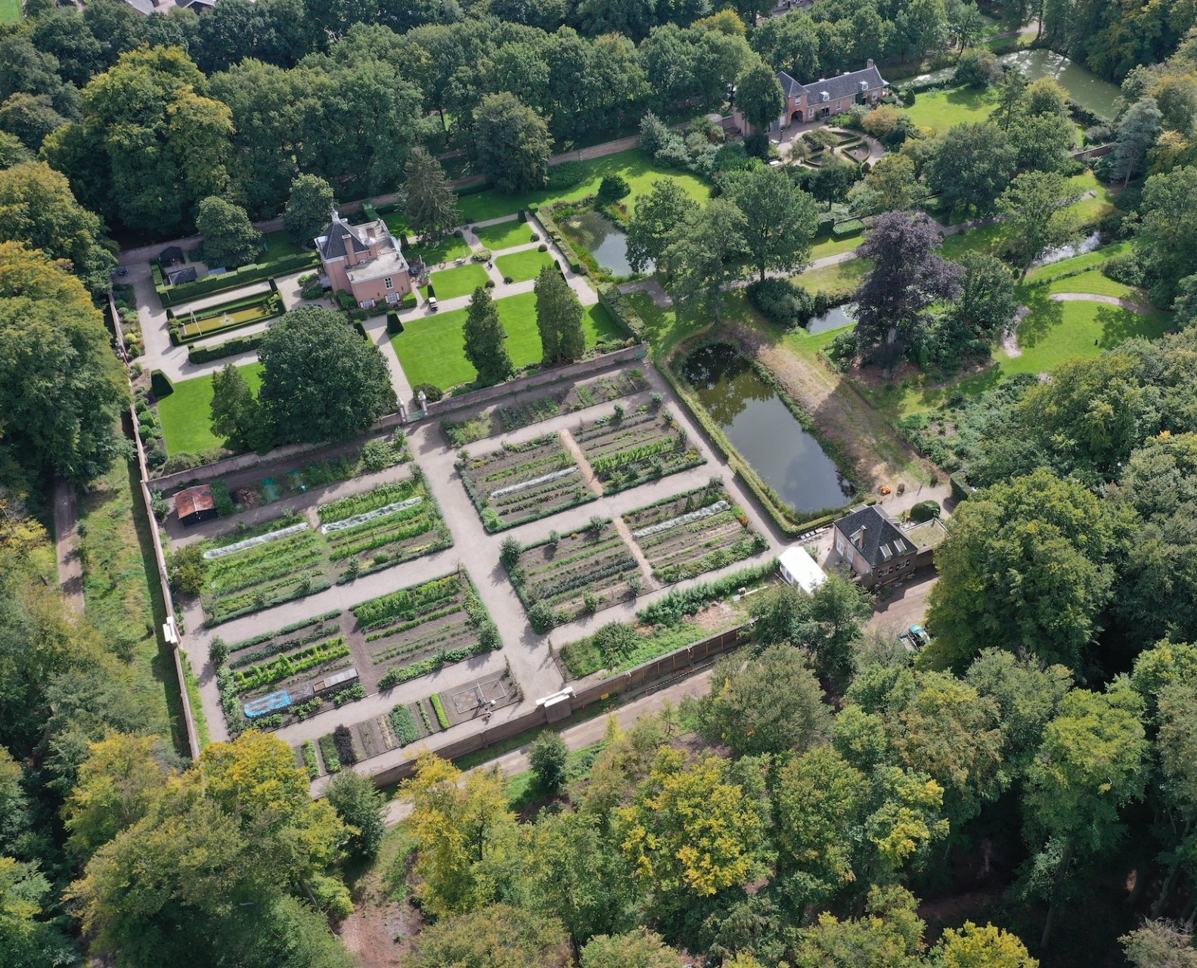
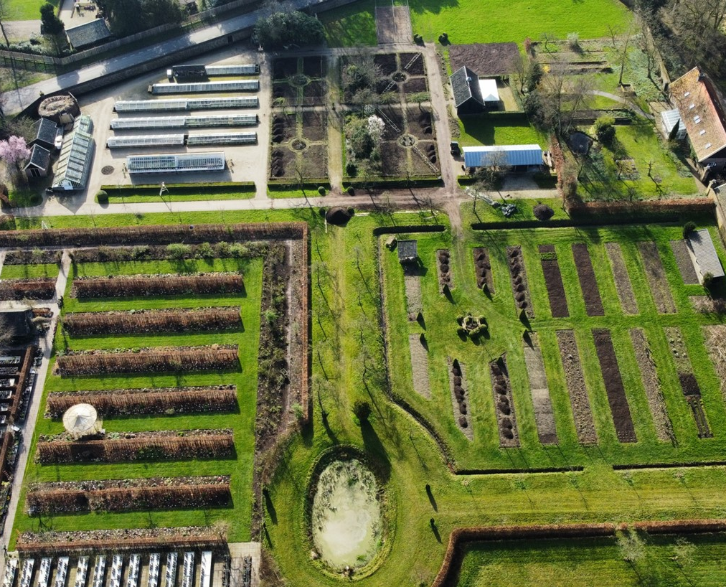
The numbers
Total ca 7.000 ha
50% agricultural land
50% forest and nature reserves
2 monumental parks in English style
2 monumental kitchen gardens
Lage en
Brecklenkamp
500 ha
Twickel
4.300 ha
Nettelhorst
114 ha
Zuidwijk en Santhorst
220 ha
Hof te Borculo
Zuylestein
156 ha
Hof te Dieren
1.000 ha
Geldersche Waard
300 ha

Slide 5
The numbers
Zuylestein
Ca.1632
Reconstructed in 2015
Original Stoopendaal drawing
Twickel
Ca. 1890
Renovated in 1990
Notes:
The kitchen garden of Zuylestein is a recent addition to our portfolio, because only this march the Zuylestein estate was handed over to Twickel foundation by the previous owner, Jemima de Brauwere. She has managed the estate since 2012, and she was the driving force behind the reconstruction of the renaissance style kitchen garden three years later.
The Twickel kitchen garden as you can visit today was designed much later, in 1890. This garden almost disappeared 100 years later, but has been renovated following the efforts of the then head gardener, the dutch foundation on orangeries and greenhouses and local volunteers / activists.

Slide 6
The numbers
Zuylestein
0,3 ha growing surface
1 ha additional growing surface outside historical garden.
1,8 fte professional gardener
25 volunteers, 16h/week (9 fte)
Open 3 days/week, year round
Café, small shop.
Produce sold in shop, vegetable subscriptions and to local restaurants
Flowers and vegetables
Notes:
Volunteers run the café and the shop.
Vegetable subscriptions are only 15 people

Slide 7
The numbers
Twickel
0,3 ha growing surface (2,67 ha total surface, partly rented out)
2 green houses and 3 pits.
0,8 fte professional gardener
25 volunteers, 8h/week (3 fte)
Open 2 afternoons/week, 7 months
Small shop.
Produce sold in shop and to local restaurants.
Flowers, annual plants, fruit trees and vegetables.

Slide 8
Exploitation
Twickel
Subject | Cost (€)
Maintenance monumental infrastructure | 20.000,-
Professional gardener (0,8 fte) | 55.000,--
Gas for the greenhouses | 17.500,--
Seeds, fertilizer and propagating material | 10.000,--
Cleaning, yearly barbecue for volunteers | 2.000,--
Small tools, miscellaneous | 500,--
SUBTOTAL | 105.000,--
 | Income (€)
Flowers and vegetable sales | 15.000,--
Subsidy for green monuments | 23.500,--
Lease to local plant grower | 3.000,--
TOTAL profit – cost | (63.500,--)
Wat we al doen:
Nr of volunteers
Working when?
Doing what?
Notes:
What you don’t see in this exploitation are the in kind hours of the volunteers and the avoided costs of the annual plants grown for the castle gardens, the flowers and the fruit trees of special variaties that we ent ourselves.
So (not counting the maintenance of the monumental infrastructure, The kitchen garden costs us roughly 43.500,- euro/year. Although, as an estate we readily accept that some of our activities will never be profitable, we think this is on the expensive side. So one of the assignements for the future is to try and reduce the cost, while increasing the profit.
However, profit as such is not the primary goal – so renting out the kitchen garden as a nice backdrop for parties or weddings will never happen.

Slide 9
Two gardens, one vision

Slide 10
Two gardens
One vision
To pass valuable cultural heritage on to generations after us, in the best possible condition.
Notes:
‘best possible condition’ means also that this cultural heritage is alive (obvious for kitchen gardens) – people interact with it, they find meaning in it. The function is more than showing history – we like our kitchen gardens to be functional. Small spoiler – this is not the same as being profitable.

Slide 11
Two gardens
One vision
To pass valuable cultural heritage on to generations after us, in the best possible condition.
Quality is leading in every choice.
We change in order to stay the same. → we’re not a museum.
Sustainability is not even a question.
Monetary profit is a means to an end.

Slide 12
Developing a Management Strategy
Notes:
Answering the question of ‘what’s your vision on the management of these kitchen gardens?’ The honest answer is that we’re in the middle of sharpening our ideas. It’s a joint effort in which we re-evaluate if the way we run both gardens is still coherent with what we see as our task.
Natural moment to re-assess our ideas for the management of both kitchen gardens:
Zuylestein is a recent addition to our portfolio of estates.
And at Twickel the gardener who supervised the kitchen garden will retire coming december.

Slide 13
Building Blocks
Developing a Management Strategy
Historic context
Spatial context
Social context
→ leads to choices for the exploitation and vice versa.
Notes:
The future has always roots in the past, especially when you work in a historic kitchen garden. So, before sharpening our ideas for the future, we think it’s important to thouroughly understand the meaning of the kitchen garden – its place within the larger whole of the estate. That place is not only the literal location, but also the place in history and the place in the current social web.
To aid our thinking, we use (a bit freely) these dimensions that were the result of a very nice research project in 2006 – which was called ‘historical kitchen gardens with a new assignment’.
Historic context: In what time was the kitchen garden created, what historic sources do we have available? What used to be the function?
Spatial context: What is the spatial relation to the rest of the estate, what assets are available? The most iconic elements?
Social context: What is the meaning of the kitchen garden to the people visiting and working in the garden? What kind of social relations do we want to foster with this garden?
And then, last but most importantly, there is the exploitation of the kitchen garden. These building blocks and the exploitation are intertwined – because the choices of what we want to do and tell in these gardens also define the exploitation. On the other side, our possibilities in terms of budget, time, manpower and skills limit what we can do.

Slide 14
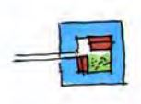
Historic Context
Building Blocks
Until 1620 In the yard
Notes:
From the middle ages until roughty 1620: In the yard, within the castle boundaries.

Slide 15
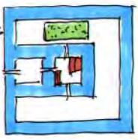
Historic Context
Building Blocks
Until 1620 In the yard
1620 – 1680 In view of the castle
Notes:
1620 – 1680: During the renaissance, things got more peaceful in the Netherlands. So it became less necessary to grow food within the castle walls. During this period, everywhere in the nehterlands kitchen gardens moved to a place outside the courtyard but still in sight of the castle.

Slide 16
Historic Context
Building Blocks
Until 1620 In the yard
1620 – 1680 In view of the castle
Zuylestein
Notes:
This is the period (around 1632) that the kitchen garden of Zuylestein was constructed by Frederik Hendrik van Oranje Nassau. Frederik Hendrik knew his classics and was interested in the arts and mathematics, which probably formed the inspiration for the garden design with a geometric lay out and straight lines.
The different gardens around the house are designed as one integrated whole of gardens and castle. The kitchen garden is integrated into this total of geometric gardens: a functional garden with a geometric plan that follows the proportions of the whole garden. This style gained followers all over Europe, and became known as ‘Dutch classism’.
The Zuylestein kitchen garden is in the Netherlands the only garden built by Frederik Hendrik in which the original early 17th century style is still largely intact and can be experienced.

Slide 18
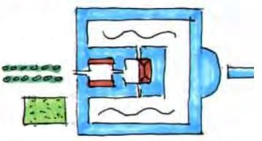
Historic context
Building blocks
Until 1620 In the yard
1620 – 1680 In view of the castle
1680 - 1815 Next to the entrance
Zuylestein
Notes:
History continues, and in the next centuries most kitchen gardens make room for landscape style ornamental gardens and move futher away from the main castle. This is also the case at Twickel, where the kitchen garden moves to a plot on the other side of the road in front of the castle.
This new fashion never reached Zuylestein, because the owners were rarely there. Large periods of time, the house was rented out and nobody ever thought it necessary to modernize the gardens.

Slide 19
Historic Context
Building Blocks
Until 1620 In the yard
1620 – 1680 In view of the castle
1680 - 1815 Next to the entrance
1815 and later Out of sight
Zuylestein
Notes:
Still later, from 1815 onwards:
The lay out of the kitchen garden itself remains square, often with four quadrants and crossing paths and a wall or hedge around the garden. But the connection to the castle disappears and the kitchen garden moves again further away.

Slide 20
Historic Context
Building Blocks
Until 1620 In the yard
1620 – 1680 In view of the castle
1680 - 1815 Next to the entrance
1815 and later Out of sight
Zuylestein
Twickel
Notes:
This situation remains to date at Twickel, where around 1890 the kitchen garden moved to a place roughly 600m from the castle.
So the points of reference in history are quite different. For Zuylestein, there is the detailed Stoopendaal drawing from 1710 that turns out to be pretty accurate. For Twickel, there are lists of what vegetables and fruit were sold to whom.

Slide 21
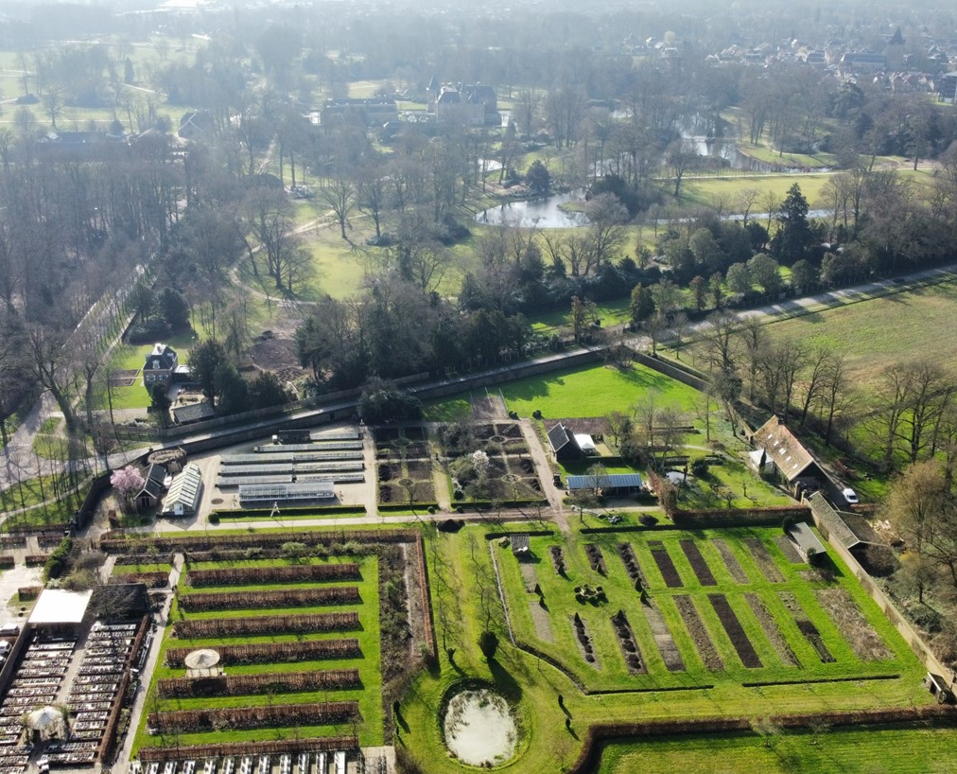
Historic Context - Function
Building Blocks
Zuylestein
Self reliant estate: feed the inhabitants and sell the surplus.
Twickel
Luxury produce for the castle and local notables.

Slide 22
Spatial Context
Building Blocks
Zuylestein
Notes:
House of Zuylestein was destroyed in the second worldwar, and rebuilt at a different place.

Slide 23
Spatial Context
Building Blocks
Zuylestein
N
Notes:
The orange square marks the original place of the house. Orange arrow indicates the north.

Slide 24
Spatial Context
Building Blocks
Zuylestein
Walled, as part of geometric garden
N
Notes:
The wall, with the entrances and even some places tot sit and enjoy the garden. Assuming that the pond, the walls and the orangery are still at their original places, the Stoopendaal drawing turned out to be very accurate.

Slide 25
Spatial Context
Building Blocks
Zuylestein
Walled, as part of geometric garden
Square vegetable beds
N

Slide 26
Spatial Context
Building Blocks
Zuylestein
Walled, as part of geometric garden
Square vegetable beds
Orangery
N
Notes:
Orangery, to protect the plants that cannot survive in our normal winter temperatures. The orangery is now in use as a small store and café. It’s occasionaly rented out as a place for meetings.

Slide 27
Spatial Context
Building Blocks
Zuylestein
Walled, as part of geometric garden
Square vegetable beds
Orangery
Arbres nains - Naantjes
N
Notes:
In the early 17th century people began to experiment with controling the growth of fruit trees, by enting and pruning. In Dutch these trees are called ‘naantjes’, which is a phonetic translation of the french ‘arbre nain’ or dwarf tree.

Slide 28
Spatial Context
Building Blocks
Zuylestein
Walled, as part of geometric garden
Square vegetable beds
Orangery
Arbres nains - Naantjes
Cold frame
N
Notes:
No green houses. The cold frames have been reconstructed at the same place where they used to sit according to the Stoopendaal drawing.

Slide 29
Spatial Context
Building Blocks
Twickel
Notes:
The lay out is similar in the sense that the north – south orientation is the same, there’s a square structure for the main paths and a wall around the garden. But, since these gardens date from a different period, there are of course also many differences.
The kitchen garden of Twickel is much larger: about 2,6 ha, and much further away from the castle.

Slide 30
Spatial Context
Building Blocks
Twickel
Twickel castle
N
Notes:
The lay out is similar in the sense that the north – south orientation is the same, there’s a square structure for the main paths and a wall around the garden. But, since these gardens date from a different period, there are of course also many differences.
The kitchen garden of Twickel is much larger: about 2,6 ha, and much further away from the castle.

Slide 31
Spatial Context
Building Blocks
Twickel
Twickel castle
Space to grow new espaliers
N
Notes:
We started this year with an ‘entery’. It was common practice for head gardeners to grow their own espaliers, because the looks of a garden were just as important as the function. Now we can carefully prune our espalliers from the earliest age and we’re free to pick species that are not commonly available. Another advantage: these trees grow already in our specific conditions, so they’re much more likely to survive when we put them in their designated spot.

Slide 32
Spatial Context
Building Blocks
Twickel
Twickel castle
Space to grow new espaliers
Vegetable beds
N

Slide 33
Spatial Context
Building Blocks
Twickel
Twickel castle
Space to grow new espaliers
Vegetable beds
Green Houses and Cold frames
N
Notes:
Monumental greenhouses: a unique rare iron house built in 1911 and a carnation greenhouse where the carnations for the last baron were grown.
Cold frames

Slide 34
Spatial Context
Building Blocks
Twickel
Twickel castle
Space to grow new espaliers
Vegetable beds
Green Houses and Cold frames
Flower beds
N
Notes:
During summer, the bouquets in the castle are made from home-grown fresh flowers.

Slide 35
Spatial Context
Building Blocks
Twickel
Twickel castle
Space to grow new espaliers
Vegetable beds
Green Houses and Cold frames
Flower beds
Pond
N
Notes:
The lay out is similar in the sense that the north – south orientation is the same, there’s a square structure for the main paths and a wall around the garden. But, since these gardens date from a different period, there are of course also many differences.
The kitchen garden of Twickel is much larger: about 2,6 ha, and much further away from the castle.

Slide 36
Spatial Context
Building Blocks
Twickel
Twickel castle
Space to grow new espaliers
Vegetable beds
Green Houses and Cold frames
Flower beds
Pond
Commercial plant grower
N

Slide 37
Social context
Building Blocks
Zuylestein and Twickel
One professional gardener aided by 20-30 volunteers.
Very loyal groups
Open to visitors
Produce is sold locally
Notes:
For the volunteers working in the garden does give them a sense of usefullness. We do not have a therapeutic aim.
Also, both gardens are open to visitors to enjoy the surroundings.

Slide 38
Your opinion?
Developing a management strategy
Historically accurate
Large harvest
Food Production?
Notes:
Since we’re together with a large group of experts..
What do you think most important in these two kitchen gardens?

Slide 39
Your opinion?
Developing a management strategy
Historically accurate
Large harvest
Food Production?
Private
Public
Accessability?
Notes:
Accessibility –
Should we ask an entrance fee? Actively try to raise visitor numbers?

Slide 40
Your opinion?
Developing a management strategy
Historically accurate
Large harvest
Food Production?
Private
Public
Accessability?
Nett loss
Nett profit
Profitability?
Notes:
How much loss do you think is acceptable per year?

Slide 41
Your opinion?
Developing a management strategy
Historically accurate
Efficiency and large harvest
Food Production?
Private
Public
Accessability?
Nett loss
Nett profit
Profitability?
By showing
Active communication
Share knowledge?
Notes:
Share knowledge – also the question With whom? And how much time may knowledge sharing activities take?
Our vision: keep specialist skills such as the pruning of espaliers alive, research old techniques such as the growing of pineapples and melons. The work to manage the gardens has priority and time is limited, so ‘yes’ to sharing with interested professionals and ‘no’ to garden courses for the general public. Indeed we have internships available for the historic gardening students and work together with a large body of researchers.
Also, we rather show what we do than that we will put up signs and information panels – also because we are a

Slide 42
Your opinion?
Developing a management strategy
Historically accurate
Large harvest
Food Production?
Secluded
Public and free
Accessability?
Nett loss
Nett profit
Profitability?
By showing
Active communication
Share knowledge?
For the garden
For the people
Care?

